Slide 1
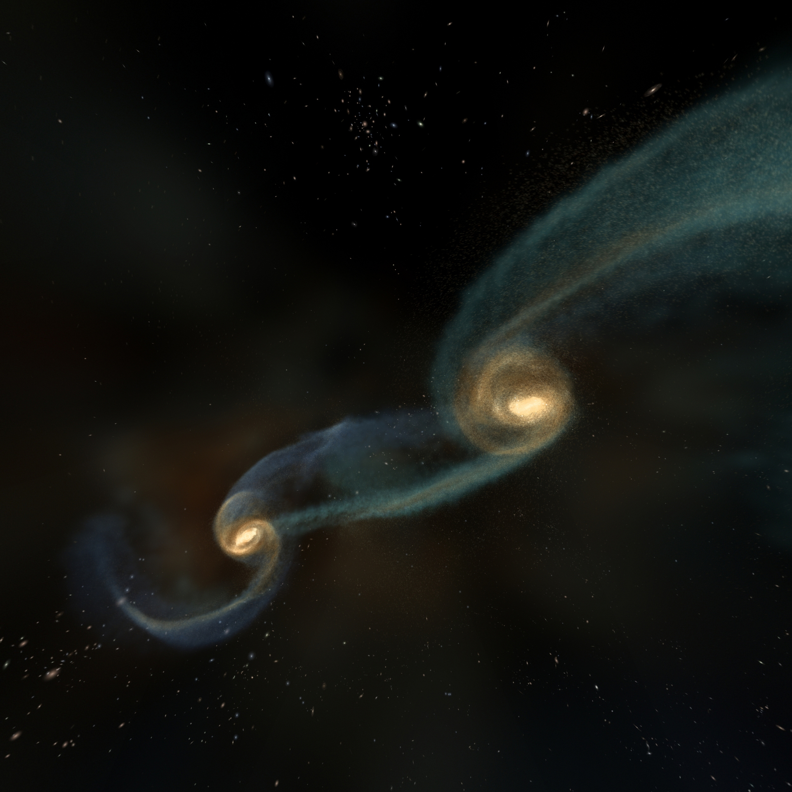
BLACK HOLES: The Other Side of Infinity
Presented by:
Lynn Cominsky
And
Kevin McLin
Sonoma State University

Slide 2
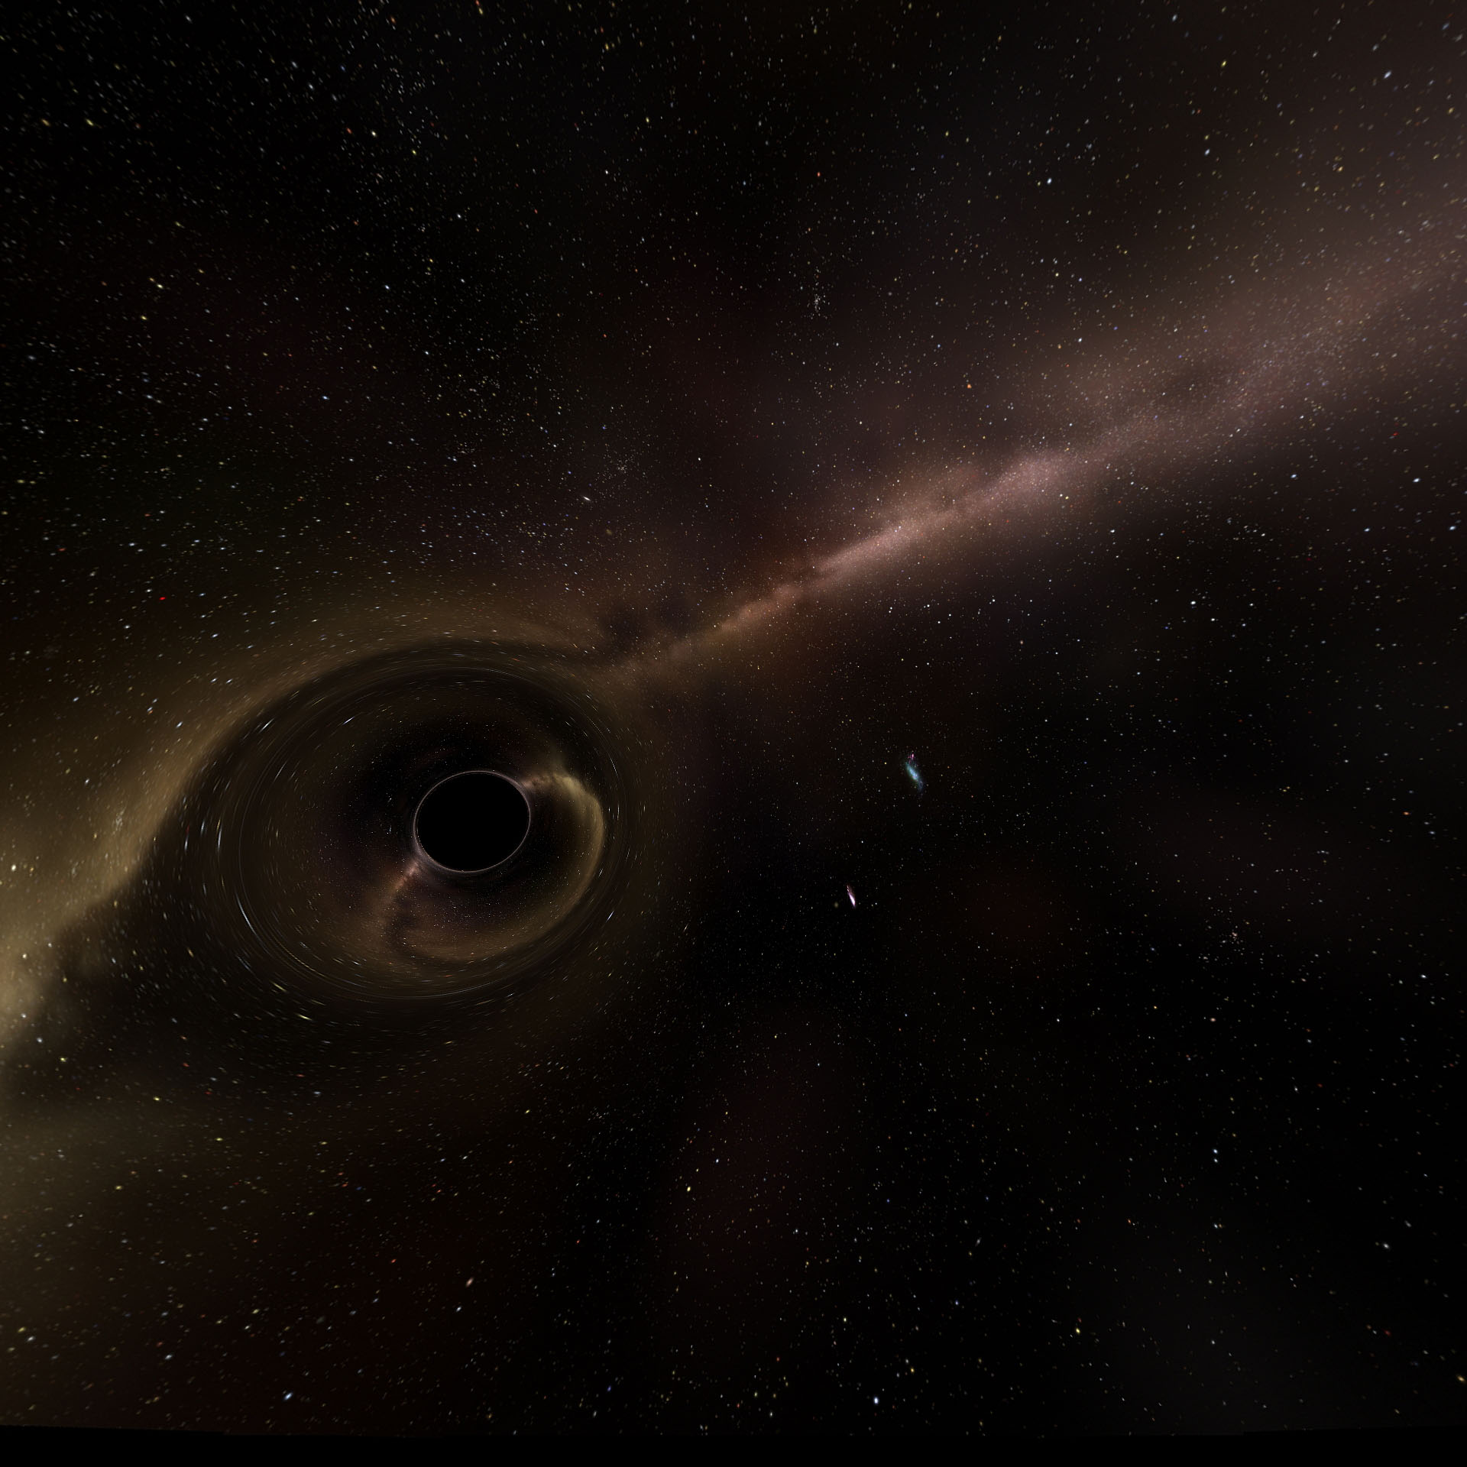
The show content
The Search for Black Holes
The Formation of Stellar-Mass Black Holes
Supermassive Black Holes
Travel Inside the Black Hole at the Center of the Milky Way
Notes:
The Search for Black Holes Though we can’t see black holes in the traditional sense, we know they exist because of the telltale signs they emit. The Swift space telescope detects gamma-ray bursts that erupt when a black hole is formed after a large star dies in a massive explosion called a supernova. In Black Holes: The Other Side of Infinity, we learn what triggers this chain of events is gravity, a force so powerful at its most extreme that it can actually warp the fabric of the cosmos.
The Formation of Stellar Mass Black Holes Black Holes: The Other Side of Infinity leads us through the process of black hole formation by focusing on a particular class of stars called red supergiants. Much more massive than our sun, these stars lead short, violent lives, truncated by the crush of gravity. The star’s core becomes so dense and massive that it collapses in on itself. The ensuing catastrophe powers a titanic supernova explosion that rocks the cosmos. Left in its wake is a black hole, an object more massive than the Sun, yet concentrated into a volume millions of times smaller—literally a puncture in the fabric of the cosmos. The gravity of the black hole is so intense, resisting it would be like trying to paddle against the current of a river plunging toward a waterfall. Anything that crosses the black hole’s point of no return, its event horizon, cannot escape.
Supermassive Black Holes Though these regular black holes seem fearsome enough, there are others that are even more immense and mind-boggling. These supermassive black holes are millions to billions of times more massive than our Sun. Scientists now believe these supermassive black holes exist in the centers of galaxies. Black Holes: The Other Side of Infinity shows us how these supermassive black holes form, and how astronomers have detected the presence of one at the center of our own Milky Way galaxy by studying the behavior of the stars around it.
Travel Inside the Black Hole at the Center of the Milky Way What if we could take a trip into the supermassive black hole at the center of the Milky Way? It’s a physical impossibility for humans, but for the first time Black Holes: The Other Side of Infinity creates this journey with scientific accuracy, using a course plotted by the observations of astronomers and guided by the equations of Einstein. What we find is a bizarre realm, a maelstrom of light, matter, and energy unlike anything we’ve ever seen or experienced before.

Slide 3
BLACK HOLES for educators
Section 1 - The Formation of Black Holes
Activity 1 – Tasty Active Galaxies
Section 2 - The gravity of the situation (around black holes)
Activity 2 - Black Hole Space Warp
Section 3 - Travel Inside the Black Hole at the Center of the Milky Way
Activity 3 - Science Fiction or Fact
Section 4 - The Search for Black Holes
Actvity 4 – Fermi Race Game and more!
Notes:
Black Hole Educator Guide
The following educational presentation is designed to follow the viewing of the Black Holes: The Other Side of Infinity planetarium show produced by the Denver Museum of Nature and Science in conjunction with the National Science Foundation (NSF) and the National Aeronautics and Space Administration’s Gamma-ray Large Area Space Telescope (GLAST) mission. The distributor of this show is Spitz Incorporated (http://www.spitzinc.com/index.html).
This accompanying educator guide has been produced by the NASA Education and Public Outreach (E/PO) Group located at Sonoma State University (SSU) in partnership with the DMNS. The SSU E/PO group supports both the GLAST mission (http://glast.sonoma.eduThis accompanying educator guide has been produced by the NASA Education and Public Outreach (E/PO) Group located at Sonoma State University (SSU) in partnership with the DMNS. The SSU E/PO group supports both the GLAST mission (http://glast.sonoma.edu) and the Swift gamma-ray burst explorer mission (http://swift.sonoma.edu). The launch of Swift on November 20, 2004 is featured at the beginning of the planetarium show.

Slide 4
Section 1
The Formation of Black Holes
Notes:
In this section, we will address the fundamental questions:
What is a black hole?
How do black holes form? Where are black holes located?
In the planetarium show, you saw two different scenarios for black hole formation – stellar mass black holes formed in supernova explosions at the ends of the lives of massive stars, and supermassive black holes formed in collisions of galaxies. We will explore these concepts further through activities that you can do with your students.

Slide 5
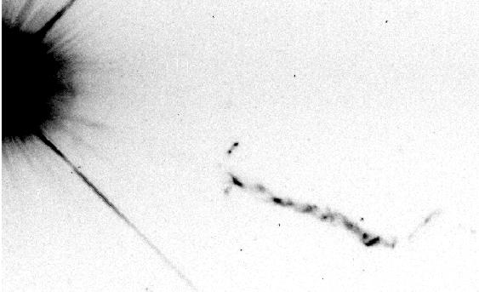
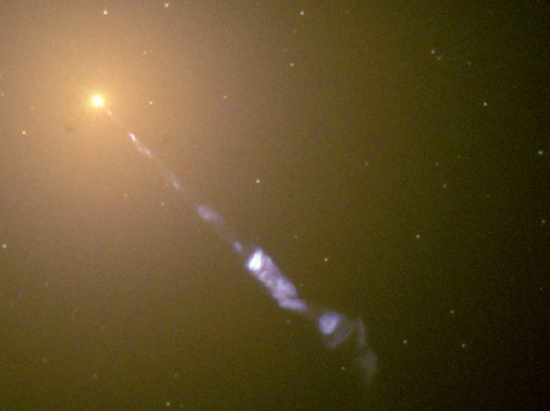
First comes first
What is a black hole?
Not just a vacuum cleaner
If you take an object and squeeze it down in size, or take an object and pile mass onto it, its gravity (and escape velocity) will go up.
Notes:
What is a black hole?
Most people think of a black hole as a voracious whirlpool in space, sucking down everything around it. But that’s not really true! A black hole is a place where gravity has gotten so strong that the escape velocity is faster than light. But what does that mean, exactly?
Gravity is what keeps us on the Earth, but it can be overcome. If you toss a rock up in the air, it will only go up a little ways before the Earth’s gravity slows it and pulls it back down. If you throw it a little harder, it goes faster and higher before coming back down. If you could throw the rock hard enough, it would have enough velocity that the Earth’s gravity could not slow it down enough to stop it. The rock would have enough velocity to escape the Earth.
For the Earth, that velocity is about 11 kilometers per second (7 miles/second). But an object’s escape velocity depends on its gravity: more gravity means a higher escape velocity, because the gravity will “hold onto” things more strongly. The Sun has far more gravity than the Earth, so its escape velocity is much higher—more than 600 km/s (380 miles/s). That’s 3000 times faster than a jet plane!
If you take an object and squeeze it down in size, or take an object and pile mass onto it, its gravity (and escape velocity) will go up. At some point, if you keep doing that, you’ll have an object with so much gravity that the escape velocity is faster than light. Since that’s the ultimate speed limit of the Universe, anything too close would get trapped forever. No light can escape, and it’s like a bottomless pit: a black hole.
The image at left shows the quasar 3C 273 and its jet. On the right is the nearby radio galaxy M87, also showing its jet. These jets are composed of material being ejected from the vicinity of the black hole at speeds very close to the speed of light. Clearly, black holes do not simply vacuum up material; they also eject some of the material back out into space.

Slide 6
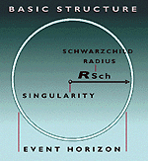
Black Hole Structure
Schwarzschild radius defines the event horizon
R_{sch} = 2GM/c²
Not even light can escape, once it has crossed the event horizon
Cosmic censorship prevails (you cannot see inside the event horizon)
Schwarzschild BH
Notes:
Schwarzschild radius is defined classically – it is the radius where the escape velocity equals the speed of light. It is equal to the event horizon only for black holes that are not spinning (so-called Schwarzschild black holes.) In 1916, Karl Schwarzschild was the first person to solve Einstein’s equations of General Relativity for a non-spinning spherical massive object. His solution applies to any slowly or non-rotating spherical object, such as the Earth or the Sun. However, in the limit where the size of the object shrinks so that the escape velocity exceeds the speed of light, we call the object a black hole. The singularity represents the place where Einstein’s equations of General Relativity fail – the equations cannot be solved at this point, because the density is infinite, and the dimensional size has collapsed to a point.

Slide 7
Let’s build an active galaxy!
Groups of two.
Grab a bowl with icing.
Take 1 half bagel.
Take 2 cones.
Take 1 marshmallow.
Take 1 toothpick.

Slide 8
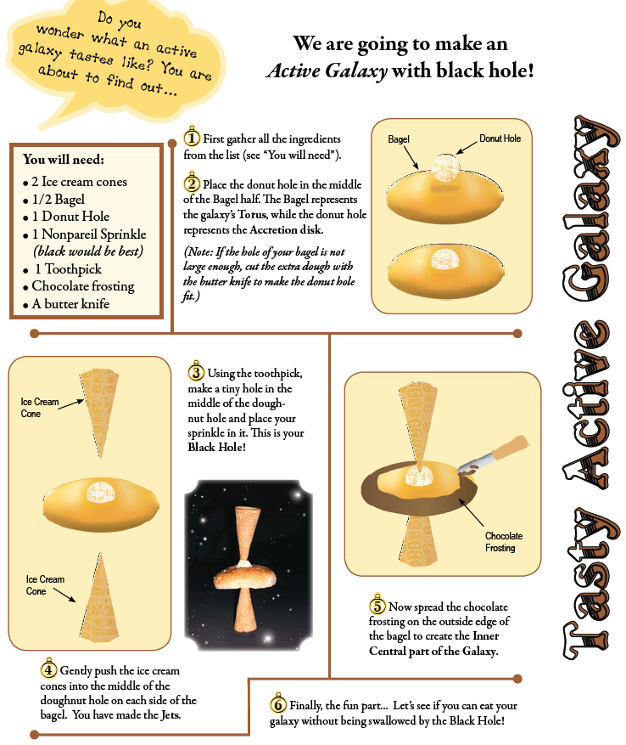
Let’s build an active galaxy!

Slide 9

AGN Pop Up Book

Slide 10
Masses of Black Holes
Primordial – can be any size, including very small (If <10¹⁴ g, they would still exist)
“Stellar-mass” black holes – must be at least 3 M_{o} (~10³⁴ g) – many examples are known
Intermediate black holes – range from 100 to 1000 M_{o} - located in normal galaxies – many seen
Massive black holes – about 10⁶ M_{o} – such as in the center of the Milky Way – many seen
Supermassive black holes – about 10⁹⁻¹⁰ M_{o} - located in Active Galactic Nuclei, often accompanied by jets – many seen
Notes:
Primordial black holes are hypothesized by many theorists, including Stephen Hawking. None have yet been detected. It is also hypothesized that the larger primordial black holes would have evaporated due to the emission of Hawking radiation by now. No Hawking radiation has yet been detected from any black holes that we have observed.

Slide 11
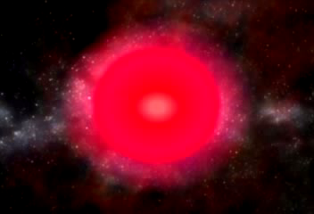
How do black holes form?
Stellar-mass black holes
Supernova: an exploding star. When a star with about 25 times the mass of the Sun ends its life, it explodes.
called a “stellar-mass black hole,” or a “regular” black hole
Notes:
How do black holes form?
The most common way for a black hole to form is probably in a supernova, an exploding star. When a star with about 25 times the mass of the Sun ends its life, it explodes. The outer part of the star screams outward at high speed, but the inner part of the star, its core, collapses down. If there is enough mass, the gravity of the collapsing core will compress it so much that it can become a black hole. When it’s all over, the black hole will have a few times the mass of the Sun. This is called a “stellar-mass black hole,” what many astronomers think of as a “regular” black hole.
Stellar-mass black holes also form when two orbiting neutron stars – ultra-dense stellar cores left over from one kind of supernova – merge to produce a short gamma-ray burst, a tremendous blast of energy detectable across the entire observable Universe. Gamma-ray bursts are in a sense the birth cries of black holes.

Slide 12
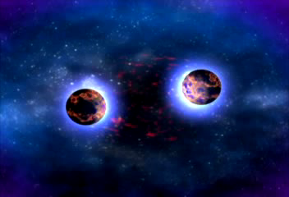
How do black holes form?
Stellar-mass black holes
Stellar-mass black holes also form when two orbiting neutron stars – ultra-dense stellar cores left over from one kind of supernova – merge to produce a short gamma-ray burst.
Notes:
How do black holes form?
The most common way for a black hole to form is probably in a supernova, an exploding star. When a star with about 25 times the mass of the Sun ends its life, it explodes. The outer part of the star screams outward at high speed, but the inner part of the star, its core, collapses down. If there is enough mass, the gravity of the collapsing core will compress it so much that it can become a black hole. When it’s all over, the black hole will have a few times the mass of the Sun. This is called a “stellar-mass black hole,” what many astronomers think of as a “regular” black hole.
Stellar-mass black holes also form when two orbiting neutron stars – ultra-dense stellar cores left over from one kind of supernova – merge to produce a short gamma-ray burst, a tremendous blast of energy detectable across the entire observable Universe. Gamma-ray bursts are in a sense the birth cries of black holes.

Slide 13
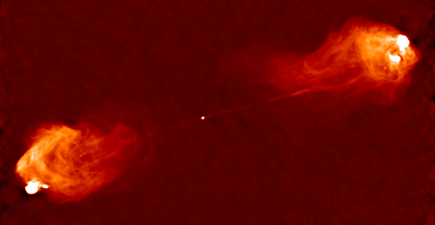
How do black holes form?
Supermassive black holes
lurk in the centers of galaxies, and are huge
millions or even billions of times the mass of the Sun!
Most likely formed at the same time as their parent galaxies, but exactly how is not known for sure.
Astronomers think there is a supermassive black hole in the center of nearly every large galaxy, including our own Milky Way.
Notes:
How do black holes form?
There are also monsters, called supermassive black holes. These lurk in the centers of galaxies, and are huge: they can be millions or even billions of times the mass of the Sun! They probably formed at the same time as their parent galaxies, but exactly how is not known for sure. Perhaps each one started as a single huge star which exploded to create a black hole, and then accumulated more material (including other black holes). Astronomers think there is a supermassive black hole in the center of nearly every large galaxy, including our own Milky Way.
Recent evidence has indicated that the size of a galaxy’s bulge is directly correlated with the mass of its central black hole. This indicates that the size of the black hole influences the evolution of its parent galaxy, or that they have both formed at the same time. Astronomers are still debating which came first – the black hole or the galaxy. Did the material collapse to form a galaxy and its central region collapsed further to form a black hole? Or did a black hole form in the early Universe and then attract material around to form a galaxy? This is an active area of research at the present time.

Slide 14
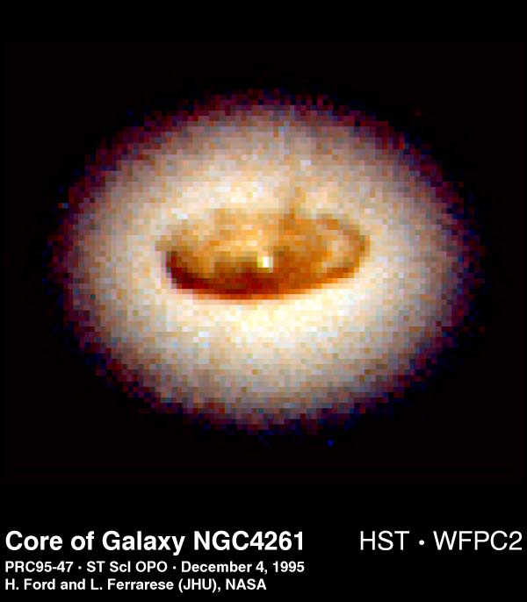
Monstrous black holes
At the heart of every galaxy lies a black hole, millions to billions times the mass of our Sun
HST/NGC 4261
800 light years
Notes:
Here is a real image of a black hole at the center of a galaxy. This image was taken by the Hubble Space Telescope. The galaxy is 100 million light years away, the black hole is a 1.2 billion solar mass black hole in a region the size of our Solar System. The Mass of disk alone is 100,000 solar masses and it is 800 light years across.
Even Hubble Space Telescope, however, does not have enough angular resolution to really image the black hole at the center of this galaxy. The central bright dot is around 200,000 times bigger than the event horizon of this supermassive black hole.

Slide 15
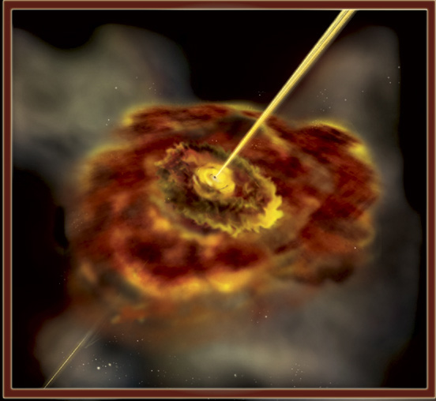
Target Object of the Day
Normal galaxy
A system of gas, stars, and dust bounded together by their mutual gravity.
VS.
Active galaxy
An galaxy with an intensely bright nucleus. At the center is a supermassive black hole that is feeding.
Notes:
A galaxy is a system of stars, gas, and dust bound together by their mutual gravity. A typical galaxy has billions of stars, and some have trillions. Although they come in many different shapes, the basic structure is the same: a dense core of stars called a ‘nucleus’ surrounded by stars and gas. In Normal galaxies the core is small, relatively faint, and composed of older, redder stars. However, in some galaxies the core is intensely bright, shining with power equivalent to trillions of suns, easily outshining the rest of the light of the galaxy combined. A galaxy that emits such tremendous amounts of energy is called an active galaxy, or AG for short. Active galaxies are actually rare, but so bright they can be seen clear across the visible universe.
At the center of these Galaxies is believed to be a supermassive black hole, millions to billions of times the mass of the Sun.

Slide 16
Active Galaxies
Show the video here

Slide 17
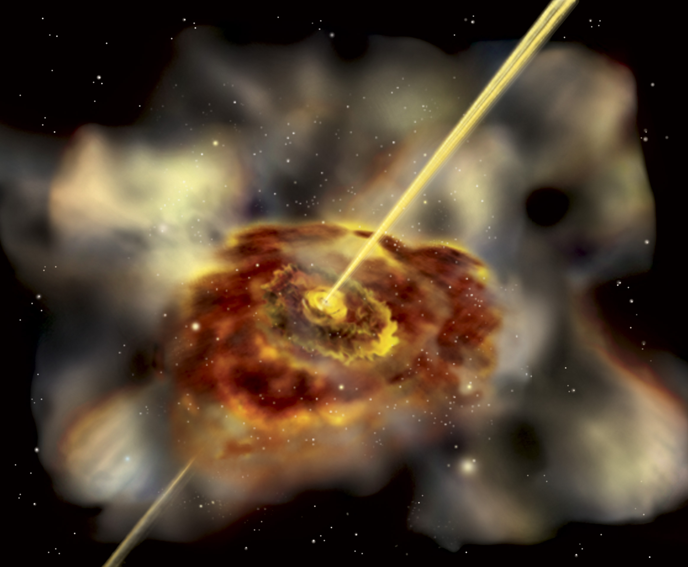
Gamma-ray Jets from Active Galaxies
Jets flare dramatically in gamma rays
Galaxies that point their jets at us are called “blazars”
How do the black holes send out jets?
Art by Aurore Simonnet

Slide 18
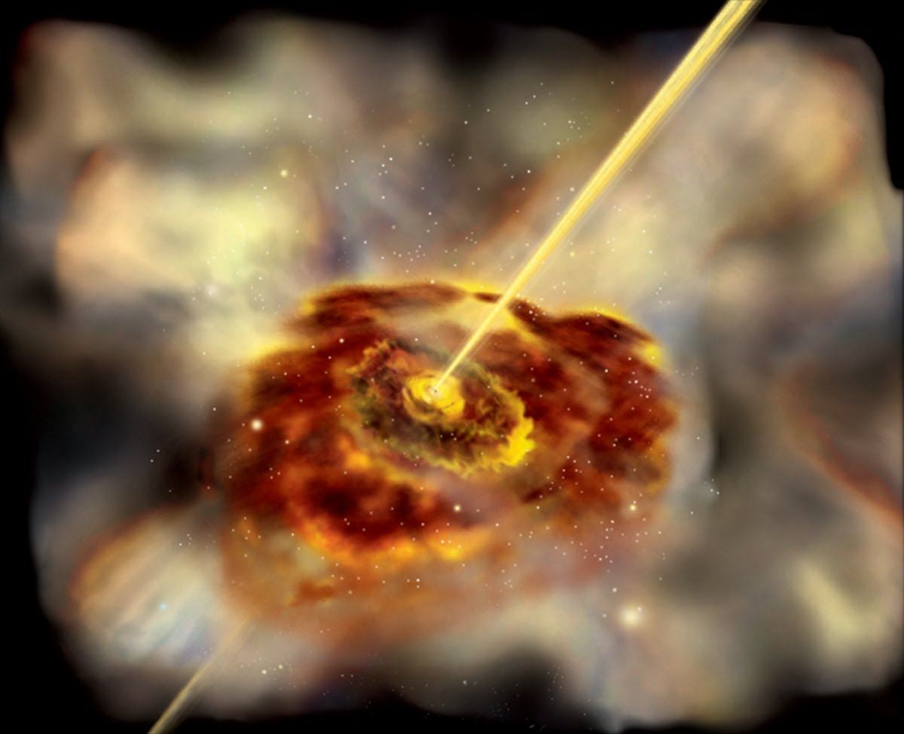
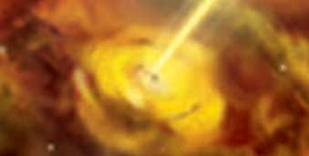
Anatomy of an active galaxy
Jet
Accretion disk
Black Hole
Inner, central part of the galaxy
Torus

Slide 19
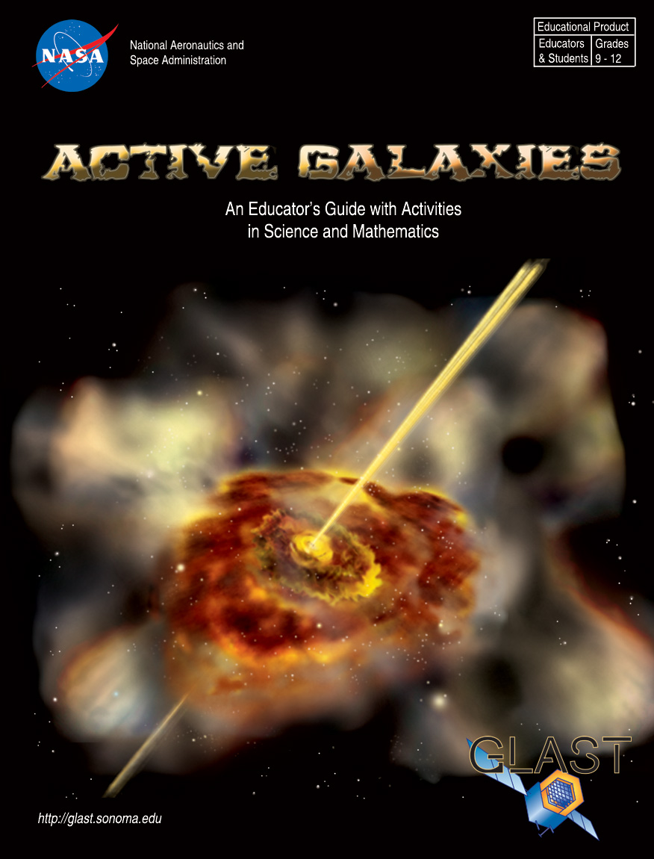
For High School Students
Active Galaxies Educator Guide
Building Perspectives with Active Galaxies
Zooming in on Active Galaxies
Light Travel Time and the Size of Active Galaxies

Slide 20
Building Perspectives
There are different components in active galaxies.
Different viewing angles lead to dramatic differences in the appearance of simple objects.
Activity: Build the active galaxy out of paper, styrofoam and toothpicks, and draw it from different angles.

Slide 21
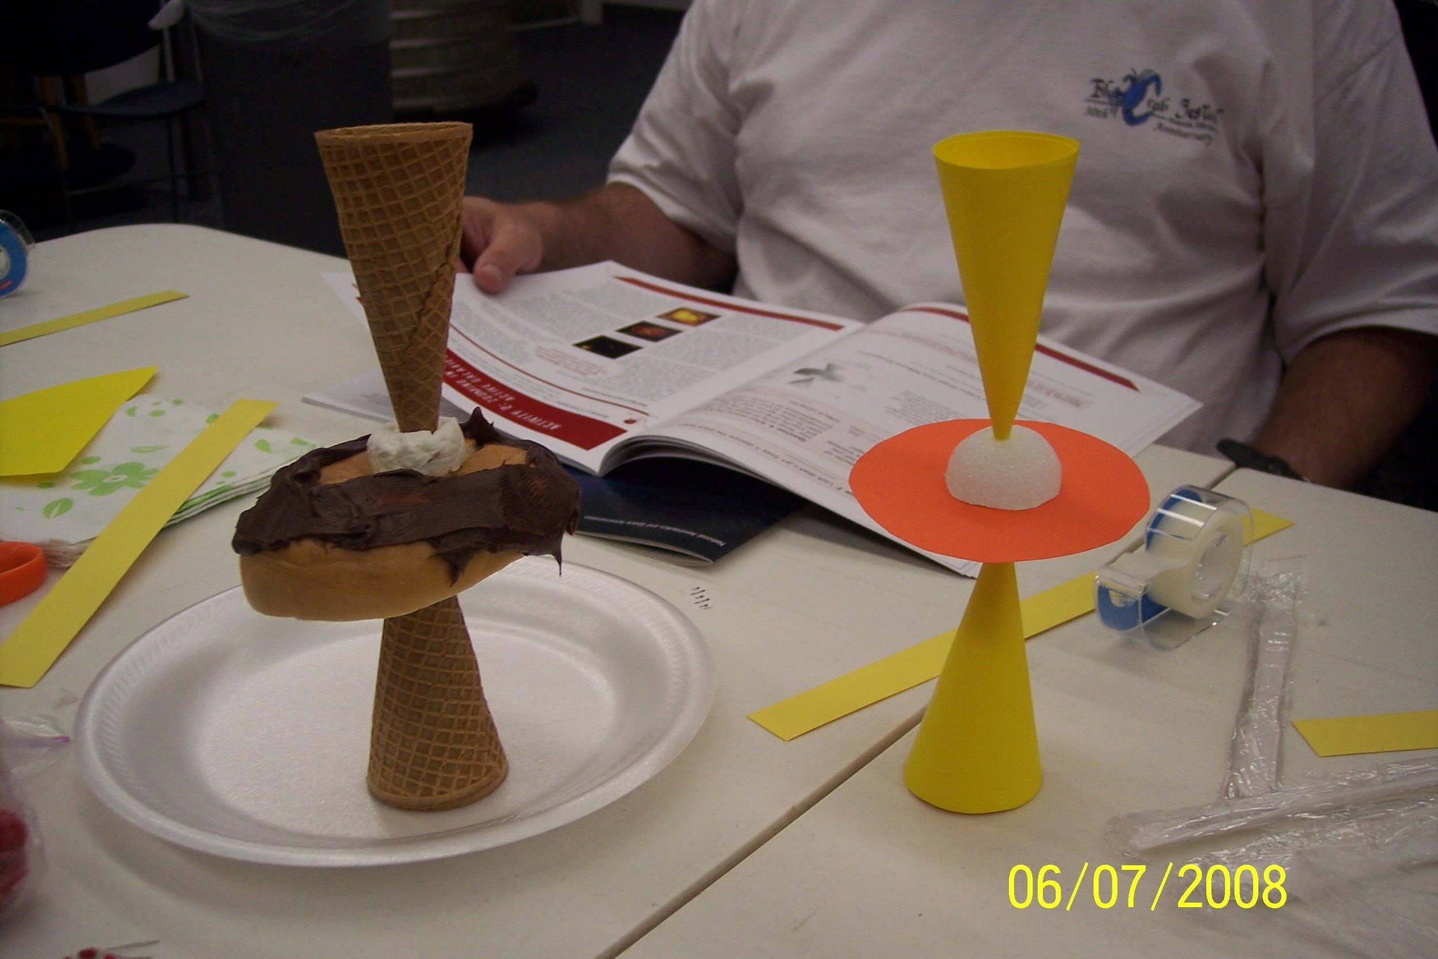
Building Perspectives
Comparing active galaxy models

Slide 22
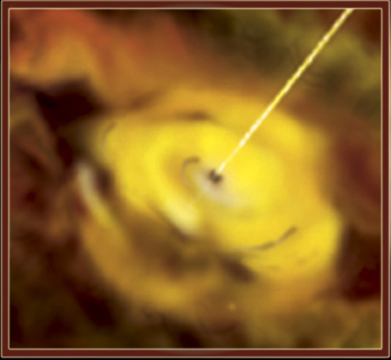
Galaxies and Black Holes
Jet
Accretion disk
Zooming in to see the central torus of an active galaxy.
Black Hole
Notes:
As matter falls toward the black hole, it forms an accretion disk, a flattened disk of material swirling around the black hole. Friction and magnetic forces inside the disk heat it to millions of degrees, and it glows brightly nearly all the way across the electromagnetic spectrum, from radio waves up to X-rays. Although our own Milky Way Galaxy has a central supermassive black hole, it is not an active galaxy. For reasons currently unknown, the black hole at the center of our Galaxy is quiescent, or inactive, as are most present-day galaxies.

Slide 23
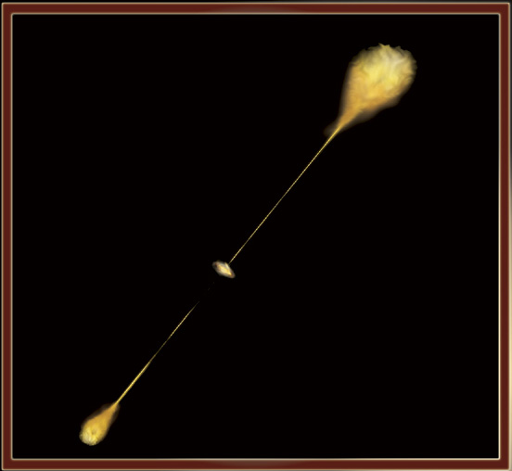
Radio Lobe Galaxy
Radio lobes
Jet
Accretion Disk
Notes:
Although the physics underlying the phenomenon is not well-understood, it is known that in some cases the accretion disk focuses long jets of matter which streak away from the core at speeds near that of light. The jets are highly collimated (meaning they retain their narrow focus over vast distances) and are emitted in a direction perpendicular to the disk. Eventually, they slow to a stop due to friction with gas well outside the galaxy, forming giant clouds of matter that radiate strongly at radio wavelengths. This is what we see here. We call this a radio lobe galaxy, because it is strongly emitting in the radio.

Slide 24
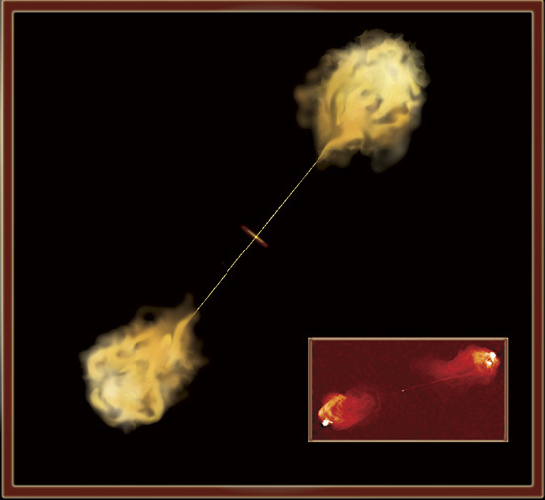
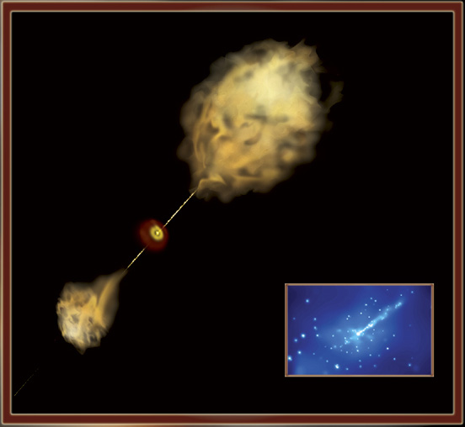
Two Views of an Active Galaxy
View at 90^{ο} from Jet
View at an angle to jet
Radio Lobe Galaxy
Seyfert Galaxy
Notes:
There are many types of active galaxies. Initially, when astronomers were first studying them, it was thought that the different types of AGs were fundamentally different objects. Now astronomers generally (but not universally) accept the unified model of AGs, meaning that most or all AGs are actually just different versions of the same object. Many of the apparent differences between types of AGs are due to viewing the AG at different orientations with respect to the disk, or due to observing the AG in different wavelengths of light. On the left we have a radio lobe galaxy (as before), the image taken here (pointing) was taken from the Very Large Array, it is the radio galaxy Cygnus A. On the right we have an Active Galaxy viewed from a different angle, the lower right is an image taken of Centaurus A- a nearby active galaxy. This image was taken from Chandra, it shows x-rays from one of the jets, diffuse gas in the galaxy, and numerous point-sources near the galactic center. Basically, here are two different views of AGs, and what makes them look different are what wavelengths they are viewed at and also the angle at which they are observed.

Slide 25
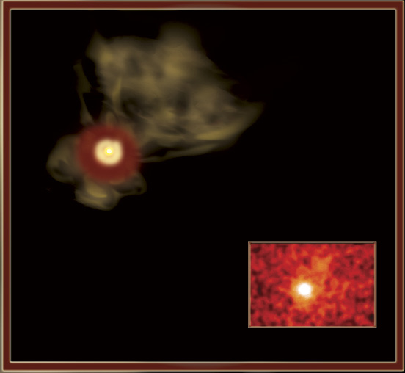
Another view of an Active Galaxy
Looking down the Jet
From this view, we see the active galaxy emitting gamma rays and X-rays.
Quasar 3C279
Blazar Galaxy
Notes:
Looking down the jet of an active galaxy we see mostly high-energy light, gamma-rays and x-rays. When we view an AG down the jet we see a Blazar. If the AG is very far away, so far away it looks like a star, we see a Quasar. Blazars are the types of active galaxies that the GLAST mission will observe.

Slide 26
Where are black holes located?
Let’s think….
They form from exploded stars…
We have one at the center of the Milky Way….
The nearest one discovered is ~1600 light years away
Black holes are everywhere!
Notes:
Where are black holes located?
Black holes are everywhere! As far as astronomers can tell, there are probably millions of black holes in our Milky Way Galaxy alone. That may sound like a lot, but the nearest one discovered is still 1600 light years away— a pretty fair distance, about 16 quadrillion kilometers! That’s certainly too far away to affect us. The giant black hole in the center of the Galaxy is even farther away: at a distance of 30,000 light years, we’re in no danger of being sucked in to the vortex.
For a black hole to be dangerous, it would have to be very close, probably less than a light year away. Not only are there no black holes that close, there aren’t any known that will ever get that close. So don’t fret too much over getting spaghettified anytime soon.

Slide 27
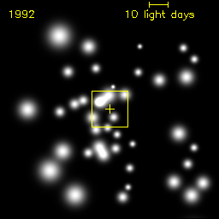
Milky Way’s BH
Zooming in to see the stars in the central parsec of the Milky Way galaxy, orbiting around – the BH!
Notes:
Ground-based Observations of Black Holes
Professor Andrea Ghez (UCLA) uses adaptive optics -- a technique which sharpens the images from the telescope by correcting for the turbulence of the Earth’s atmosphere -- on the Keck telescope to image the stars near the center of our Milky Way galaxy. These observations, taken over a ten year period, reveal stars moving at incredibly high speeds, and their orbits indicated that there is a very massive but invisible object at the center of our Galaxy. Dr. Ghez was using infrared light for the most part, because the center of the galaxy has so much dust and gas that visible light does not get out. Also she does not see the light from the accretion disk or the BH directly, she just uses the nearby stars to weigh the black hole. The mass of this object was calculated to be 4 million times the mass of our sun. The only object known that can be that massive, confined to a very small region but still dark, is a supermassive black hole.

Slide 28
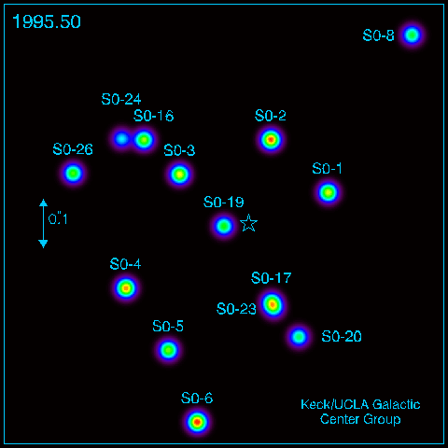
Evidence
This shows ten years worth of Prof. Ghez’ data at 2.2 microns of the stars orbiting around a 4 million solar mass black hole at the center of the Milky Way.
It also shows the star’s orbits extrapolated into the future
Note: Stars S0-2 and S0-16 provide the best data
Notes:
This is a more detailed version of the previous slide’s data, showing where the stars will orbit into the future near the center of our Milky Way galaxy. You saw a fancier version of this during the planetarium show.

Slide 29
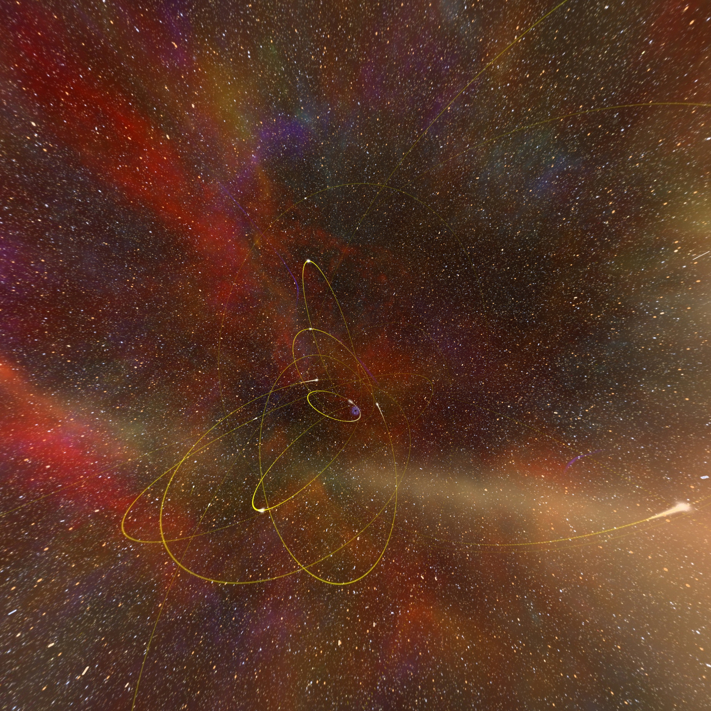
Section 3
Stars orbiting our central supermassive black hole
Notes:
Snapshot of stars orbiting the black hole at the center of the Milky Way Galaxy as taken from the planetarium show.

