Slide 1
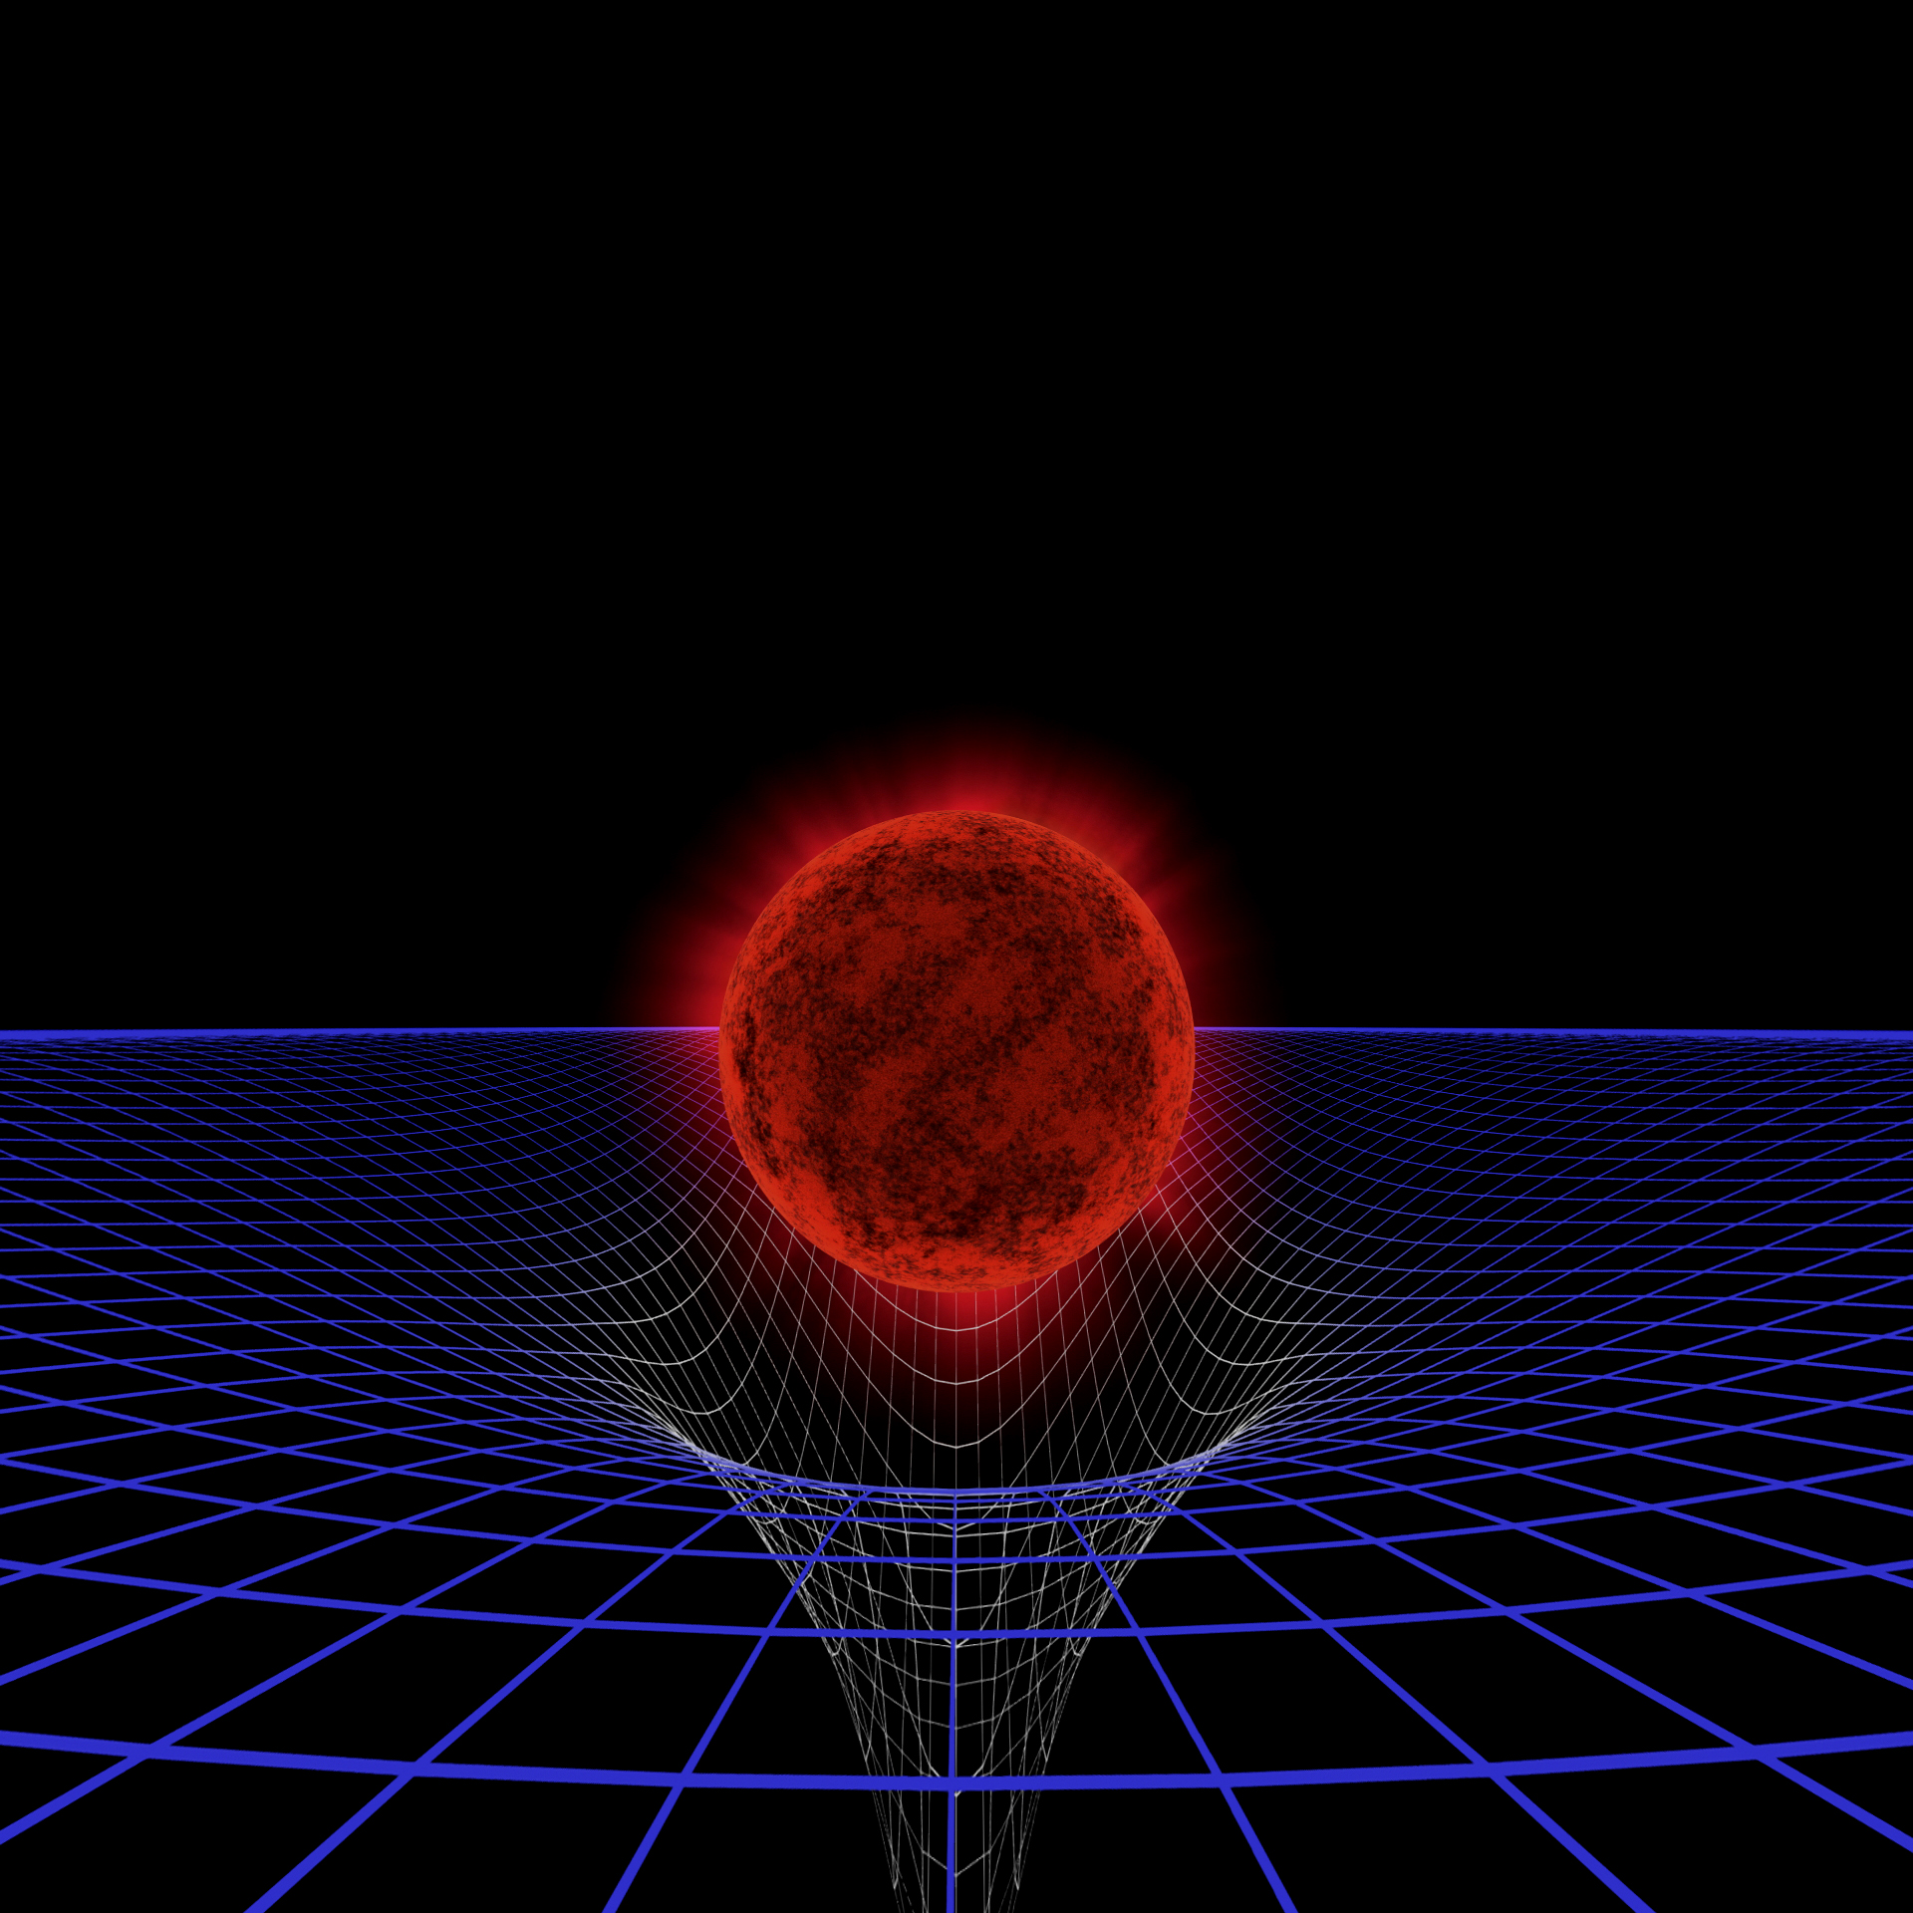
Section 2
The gravity of the situation (around black holes)
Notes:
In this section, we will address the fundamental questions:
How do black holes affect things near them?
What happens when you fall into a black hole?
In the planetarium show you saw different depictions of spacetime using grids. We will explore the concept of spacetime further through activities that you can do with your students.

Slide 2
Black Hole Space Warp
In groups
  Have two people hold the hoop horizontally.
  Place the weight at the center of the hoop.
  Have two people slowly toss in the bouncy balls one at a time. Toss them so that they are near the edge of the hoop when you release them.
  Observe what happens to the path and the speed of the balls.
  Repeat this 3 times.
Notes:
The black hole space warp activity is a two-dimensional representation of the warping of three-dimensional space. In the planetarium show, there was a sequence in which a three-dimensional grid was represented (right after Einstein’s image appears, about 4 minutes and 40 seconds into the show.) This sequence dissolved into the typical two-dimensional representation shown here. However, it is important to realize that space is equally warped in all directions around the massive body, not just in a plane.

Slide 3
Black Hole Space Warp
Record the following questions based on your observations.
    What do the moving balls represent?
    What does the weight represent?
    What happened to the balls?
    What does the blue latex material represent?
    What happens to the material when the bouncy balls roll around?

Slide 4
How do black holes affect things near them?
Are we in danger of being gobbled up by a black hole?
The gravity from a black hole is only dangerous when you’re very close to it.
If the Sun were to suddenly become a black hole (don’t worry, it’s way too lightweight to ever do that), what would happen to the Earth?
Every few hundred thousand years, a star wanders too close to the black hole and gets torn apart. This produces a blast of X-rays that can be visible for decades!
Notes:
How do black holes affect things near them?
Are we in danger of being gobbled up by a black hole? Actually, no. We’re pretty safe.
The gravity from a black hole is only dangerous when you’re very close to it. Surprisingly, from a large distance, black hole gravity is no different than the gravity from a star with the same mass. The strength of gravity depends on the mass of the object and your distance from it. If the Sun were to become a black hole (don’t worry, it’s way too lightweight to ever do that), it would have to shrink so much that its event horizon would be only 6 km (4 miles) across. From the Earth’s distance of 150 million km (93 million miles), we’d feel exactly the same gravity as we did when the Sun was a normal star. That’s because the mass didn’t change, and neither did our distance from it. But if we got up close to the black hole, only a few kilometers away, we’d definitely feel the difference!
So stellar-mass black holes don’t go around tearing up stars and eating everything in sight. Stars, gas, planets, and anything else would have to get up close and personal to a black hole to get trapped. But space is big. The odds of that happening are pretty small.
Things are different near a supermassive black hole in the center of a galaxy. Every few hundred thousand years, a star wanders too close to the black hole and gets torn apart. This produces a blast of X-rays that can be visible for decades! Events like this have been seen in other galaxies, and they are a prime target for X-ray satellites such as the Chandra observatory and XMM-Newton to reveal otherwise “dormant” black holes.

Slide 5
How do black holes affect things near them?
Stars in the inner parts of a galaxy orbit the galactic center faster when the galaxy’s central supermassive black hole is more massive.
Astronomers conclude that the total mass of the inner region of a galaxy is proportional to the (relatively very small) mass of its central black hole!
It’s as if the formation of that black hole somehow affected the formation of the billions of normal stars around it.
Notes:
How do black holes affect things near them?
Astronomers have found another amazing thing about galaxies: the stars in the inner parts of a galaxy orbit the galactic center faster when the galaxy’s central supermassive black hole is more massive. Since those stars’ velocities are due to the mass in the inner part of the galaxy – and even a monster black hole is only a tiny fraction of that mass – astronomers conclude that the total mass of the inner region of a galaxy is proportional to the (relatively very mall) mass of its central black hole! It’s as if the formation of that black hole somehow affected the formation of the billions of normal stars around it.

Slide 6
What happens when you fall into a black hole?
If you fall into a black hole
You’re doomed.
Sure, once you fall in you can never get back out, but it turns out you’ll probably be dead before you get there.
Notes:
What happens when you fall into a black hole?
If you fall into a black hole, you’re doomed. Sure, once you fall in you can never get back out, but it turns out you’ll probably be dead before you get there.
The gravity you feel from an object gets stronger the closer you get. As you approach a stellar-mass black hole feet-first, the force of gravity on your feet can be thousands of times stronger than the force on your head! This has the effect of stretching you, pulling you apart like taffy. Tongue-in-cheek, scientists call this “spaghettification.” By the time you reach the black hole, you’ll be a thin stream of matter many miles long. It probably won’t hurt though: even falling from thousands of kilometers away, the entire gory episode will be over in a few milliseconds.
You may not even make it that far. Some black holes greedily gobble down matter, stealing it from an orbiting companion star or, in the case of supermassive black holes, from surrounding gas clouds. As the matter falls in, it piles up into a disk just outside the hole. Orbiting at huge speeds, the matter in this accretion disk gets extremely hot—even reaching millions of degrees. It will spew out radiation, in particular high-energy X-rays. Long before the black hole could rip you apart you’d be fried by the light. But suppose you somehow manage to survive the trip in. What strange things await you on your way down into forever?
Once you pass the point where the escape velocity is faster than light, you can’t get out. This region is called the event horizon. That’s because no information from inside can escape, so any event inside is forever beyond our horizon.
If the black hole is rotating, chaos awaits you inside. It’s a maelstrom as infalling matter turns back on the incoming stream, crashing into you like water churning at the bottom of a waterfall. At the very core of the black hole the seething matter finally collapses all the way down to a point. When that happens, our math (and intuition) fails us. It’s as if the matter has disappeared from the Universe, but its mass is still there. At the singularity, space and time as we know them come to an end.

