Slide 1
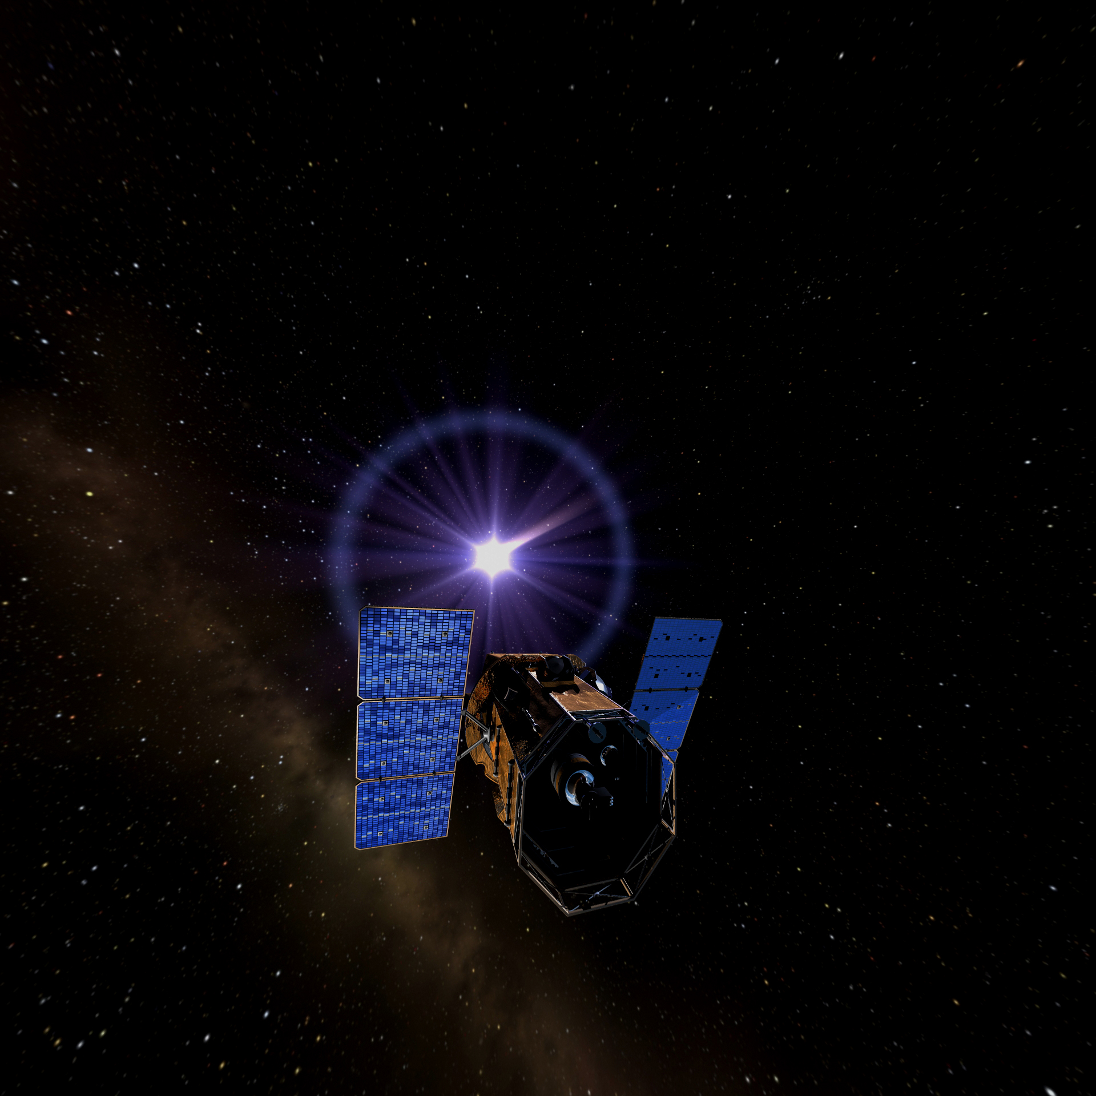
Section 4
The Search for Black Holes
Notes:
The Search for Black Holes
In this section, you will learn about some of the observations that scientists are making from the ground and from space-based satellites that provide evidence for the different types of black holes that we have been discussing in the earlier sections. You will also learn about a few of the more exotic predictions of Einstein’s general theory of relativity and work in progress to test these predictions.
In this section, we will address the fundamental questions:
What can we learn from black holes?
If black holes are black, how can we find them?

Slide 2
What can we learn from black holes?
As matter falls into a black hole, it heats up and emits X-rays.
Current data indicate we may be missing as many as 80% of the black holes.
Unanswered questions:
What happens at the very edge of a black hole?
Where light cannot escape?
Where space and time swap places?
Where even Einstein’s General Relativity is stretched to the breaking point?
Notes:
What can we learn from black holes?
Black holes represent the ultimate endpoints of matter. They twist and rip space and time, pushing our imagination to its limits. But they also teach us a lot about the way the Universe works.
As matter falls into a black hole, it heats up and emits X-rays. By studying how black holes emit X-rays, scientists can learn about how black holes eat matter, how much they can eat, and how fast they can eat it — all of which are critical to understanding the physics of black holes. Current data indicate we may be missing as many as 80% of the black holes in the Universe because of this dust, future missions will give astronomers a more accurate census of the black hole population. What happens at the very edge of a black hole, where light cannot escape, where space and time swap places, where even Einstein’s General Relativity is stretched to the breaking point? Black holes are a natural laboratory where we can investigate such questions.
Einstein predicted that when a black hole forms, it can create ripples in the fabric of space, like the waves made when you throw a rock in a pond. No one has ever detected these gravitational waves, but scientists are building experiments right now to look for them. If they are detected, these waves can teach us much about how gravity works. Some scientists even think gravitational waves were made in the Big Bang. If we can detect these waves, it will be like looking back all the way to Time Zero, the start of everything there is.
Falling into a black hole would be the last thing you’d ever do, but for scientists, black holes are just the beginning of our exploration of space, time, and everything in between.

Slide 3
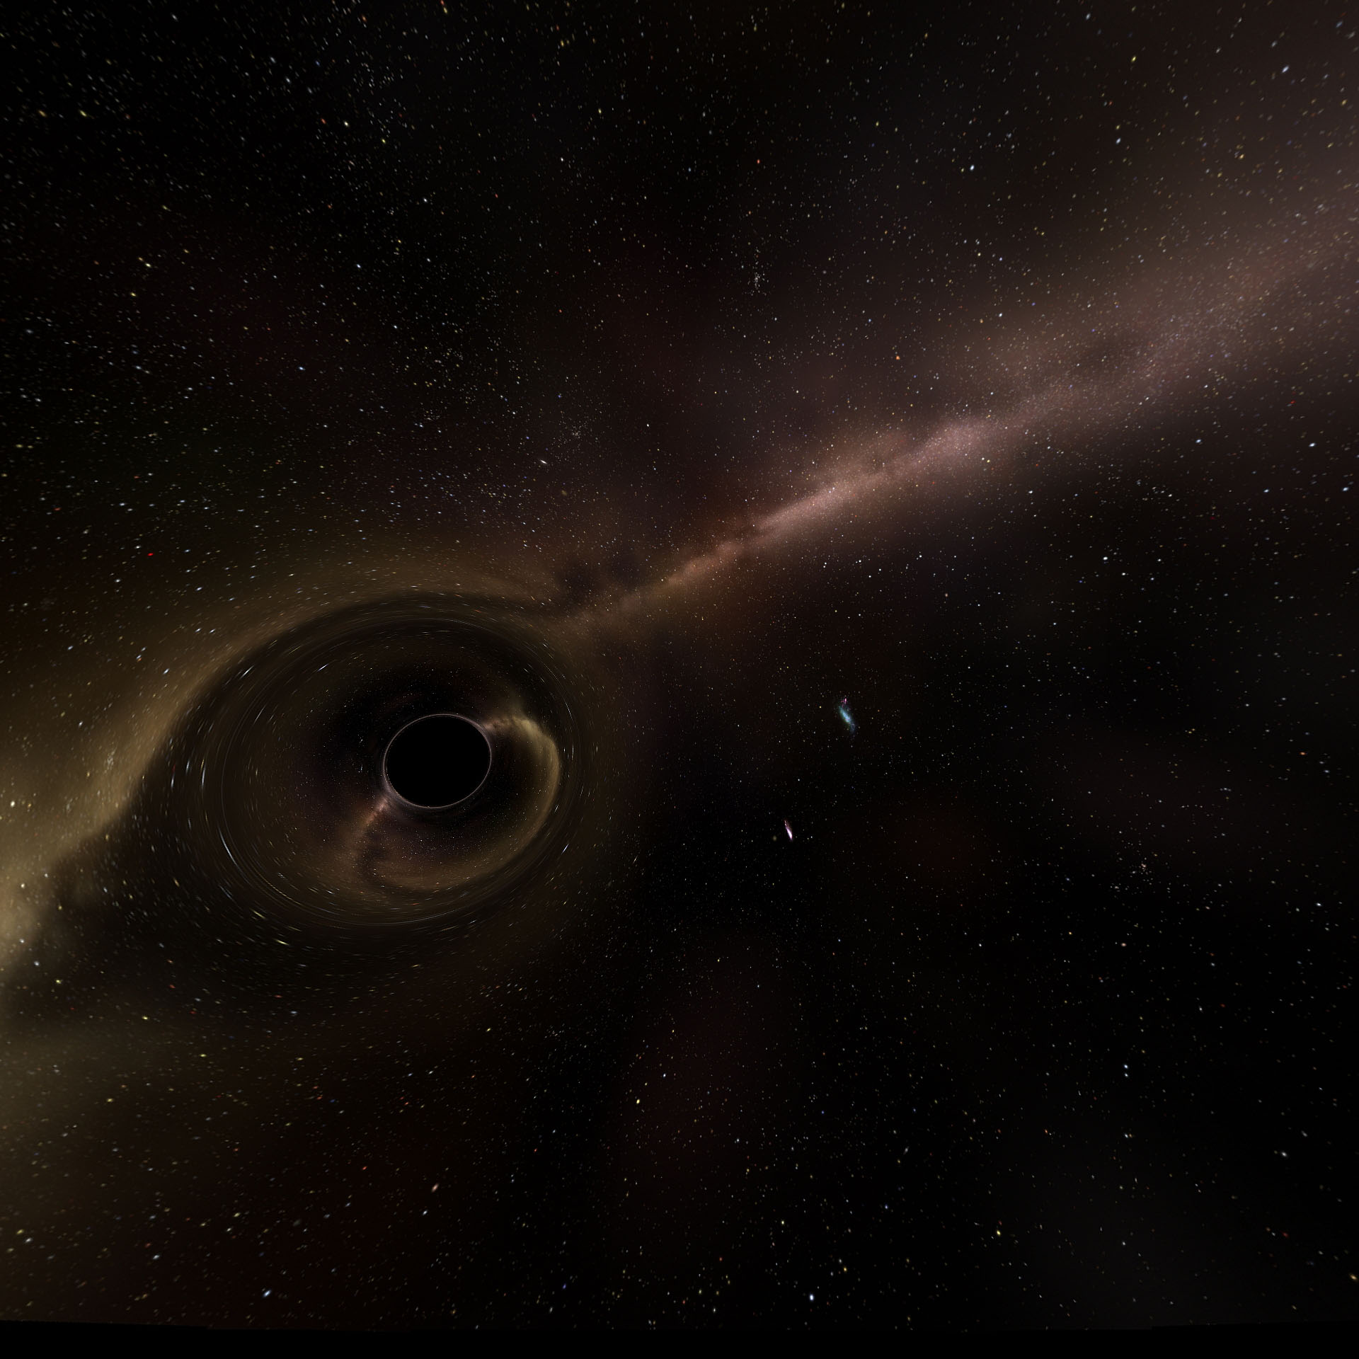
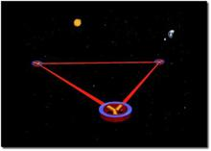
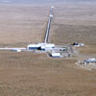
What can we learn from black holes?
Gravitational waves
ripples in the fabric of space
can teach us much about how gravity works
scientists even think gravitational waves were made in the Big Bang
LIGO and LISA may some day have some answers!
LISA
LIGO
Notes:
Gravitational Waves
The Laser Interferometer Gravitational-wave Observatory (LIGO) is currently taking data at two locations: Hanford, Washington and Livingston, Louisiana. LIGO is searching for gravitational waves created in supernova collapses of stellar cores (which form neutron stars and black holes), collisions and coalescences of neutron stars or black holes, rotations of neutron stars with deformed crusts and the remnants of gravitational radiation created by the birth of the universe. Each LIGO facility houses a laser interferometer, consisting of mirrors suspended at each of the corners of a gigantic L-shaped vacuum system, measuring 4 kilometers (2.5 miles) on each side. Precision laser beams in the interferometer sense small motions of the mirrors, which are caused by gravitational waves.
Gravitational waves that originated hundreds of millions of light years from earth are expected to distort the 4 kilometer mirror spacing by about a thousandth of a Fermi (less than one trillionth of the diameter of a human hair).
http://www.ligo.caltech.edu/
LISA (Laser Interferometer Space Antenna) is a proposed NASA space mission that will use a triad of satellites freely flying (not connected to each other) five million kilometers (a little more than three million miles) apart, in an equilateral triangle. The spacecraft will carry delicate instruments to track each other and, in concert, measure passing gravitational waves. As the first dedicated space-based gravitational wave observatory, LISA will detect waves generated by binaries within our Galaxy, and by massive black holes in distant galaxies.
http://lisa.jpl.nasa.gov/

Slide 4
If black holes are black, how can we find them?
Binary star systems
measure the orbit of the normal star and determine the mass of the black hole
X-ray signatures
The first black hole, Cygnus X-1, was identified using data from the first X-ray satellite, Uhuru, in 1972
NASA’s Chandra Observatory has found indications of black holes in practically every galaxy that it has studied in detail.
Notes:
If black holes are black, how can we find them?
The black hole itself may be invisible, but the ghostly fingers of its gravity leave behind fingerprints.
Some stars form in pairs, called binary systems, where the stars orbit each other. Even if one of them becomes a black hole, they may remain in orbit around each other. By carefully observing such a system (like Dr. Andrea Ghez does, slides 20 & 21), astronomers can measure the orbit of the normal star and determine the mass of the black hole. Only a few binary systems have black holes, though, so you have to know which binaries to observe. Fortunately, astronomers have discovered a signpost that points the way to black holes: X-rays.
As described above in What happens when you fall into a black hole?, if a black hole is “eating” matter from a companion star, that matter gets very hot and emits X-rays. This is like a signature identifying the source as a black hole. That’s why astronomers build spacecraft equipped with special detectors that can “see” in X-rays. In fact, black holes are so good at emitting X-rays that many thousands can be spotted this way. The first black hole, Cygnus X-1, was identified using data from the first X-ray satellite, Uhuru, in 1972. Since then, many other x-ray satellites have studied black holes, both within our galaxy, the Milky Way, and in the cores of distant galaxies. NASA’s Chandra Observatory has found indications of black holes in practically every galaxy that it has studied in detail. And these “supermassive” black holes in distant galaxies often emit jets of particles and light that stretch out over tens of thousands of light years. When these jets are aimed directly at Earth, we can see gamma rays – light even more energetic than X-rays – beaming right at us. In fact, galaxies with gamma-ray emitting jets are the most commonly observed extragalactic source of high-energy gamma rays. And NASA’s GLAST mission should detect thousands of these types of galaxies.

Slide 5
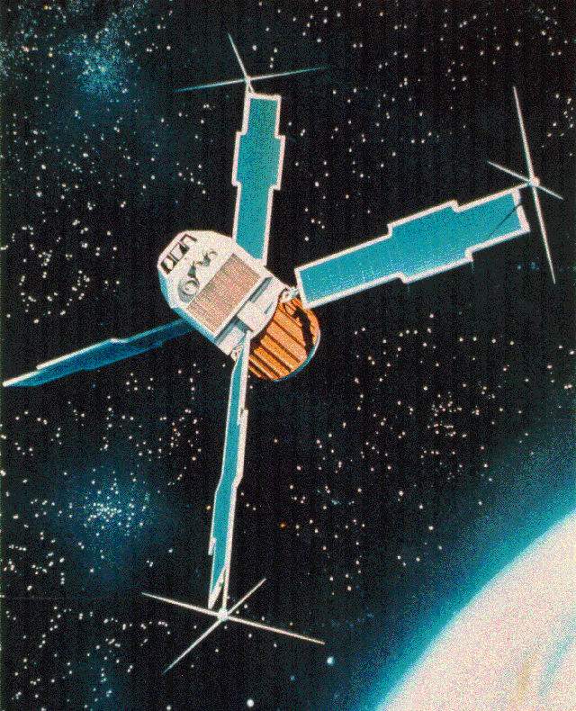
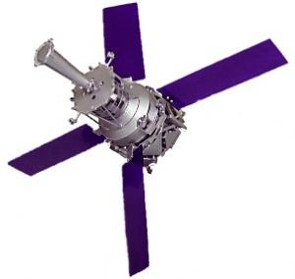
The Search for Black Holes
Uhuru Explorer Satellite
First earth-orbiting mission dedicated entirely to celestial X-ray astronomy.
Launched on 12 December 1970 from Kenya (the name “Uhuru” is Swahili for freedom)
During its two year mission it created the first comprehensive and uniform all-sky X-ray survey. It expanded the number of known cosmic X-ray sources to more than 400.
Einstein Observatory
launched on November 13, 1978
operated for more than two years.
first X-ray mission to use focusing optics and relatively high-resolution detectors.
saw for the first time X-ray jets from the supermassive black holes in the centers of galaxies Cen A and M87.
Notes:
Uhuru Explorer Satellite
Uhuru was the first earth-orbiting mission dedicated entirely to celestial X-ray astronomy. It was launched on 12 December 1970 from Kenya (the name “Uhuru” is Swahili for freedom, so-named in honor of the anniversary of Kenyan independence). During its two year mission it created the first comprehensive and uniform all-sky X-ray survey. It expanded the number of known cosmic X-ray sources to more than 400, which included many black holes, seen in X-rays for the first time.
Uhuru web site at Goddard Space Flight Center - http://heasarc.gsfc.nasa.gov/docs/uhuru/uhuru.html
Einstein Observatory
The Einstein Observatory, was a NASA mission which launched on November 13, 1978 and operated for more than two years. It was named after Albert Einstein, whose theories predicted many of the extreme phenomena, such as black holes, that were studied by this mission. It was the first X-ray mission to use focusing optics and relatively high-resolution detectors. Its sensitivity was several hundred times greater than any previous X-ray astronomy mission. During its mission it detected many black holes, and saw for the first time X-ray jets from the supermassive black holes in the centers of galaxies Cen A and M87.
Einstein web site at Goddard Space Flight Center - http://heasarc.gsfc.nasa.gov/docs/einstein/heao2.html

Slide 6
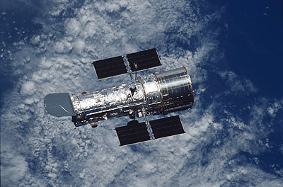
Hubble Space Telescope
Launched in April 1990
Nicknamed “The Black Hole Hunter”
ability to see gas and stars very close to black holes in the centers of galaxies.
Able to confirm the presence of black holes in many nearby galaxies, and its observations were critical in the discovery that every large galaxy has a central supermassive black hole.
Notes:
Hubble Space Telescope
The Hubble Space Telescope, launched in April 1990 and still operating today, was nicknamed “The Black Hole Hunter” because of its ability to see gas and stars very close to black holes in the centers of galaxies. It is named after famous astronomer Edwin Hubble, who first discovered that fuzzy patches of stars were actually entire galaxies, separate from our own. Its sensitivity using both images and spectroscopy allowed astronomers to map out black holes with unprecedented clarity in ultraviolet, optical, and near-infrared light. It was able to confirm the presence of black holes in many nearby galaxies, and its observations were critical in the discovery that every large galaxy has a central supermassive black hole.
NASA Hubble web site - http://hubble.nasa.gov/index.php
Hubble outreach site - http://hubblesite.org/

Slide 7
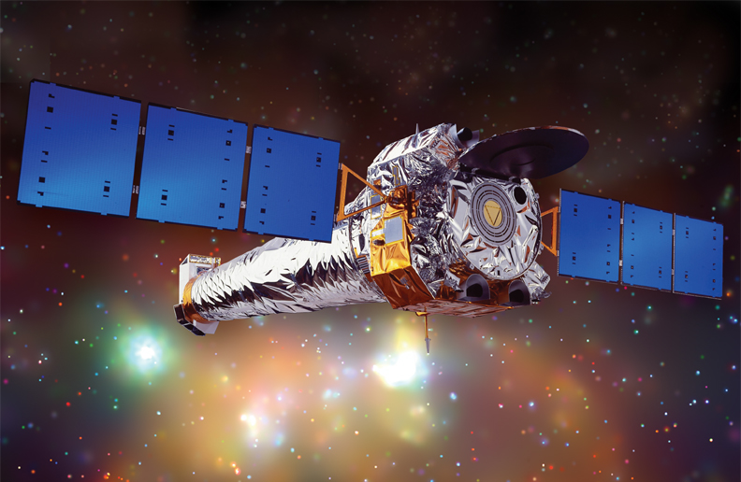
Chandra X-ray Observatory
Named in honor of the brilliant astronomer Subrahmanyan Chandrasekhar
Launched onboard the Space Shuttle Columbia on July 23, 1999
Contribution to black hole astronomy is simply huge
Mapped thousands of black holes in nearby galaxies
Confirmed discovery of intermediate black holes, a new class of black holes with masses from 100 – 1000 times the mass of the Sun.
It has studied X-ray emission from the accretion disks around black holes, and the jets coming from them as well.
Notes:
Chandra X-ray Observatory
NASA's Chandra X-ray Observatory (named in honor of the brilliant astronomer Subrahmanyan Chandrasekhar who calculated the maximum mass of neutron stars, among other contributions), was launched onboard the Space Shuttle Columbia on July 23, 1999 and is still operating today. The combination of high resolution, large collecting area, and sensitivity to higher energy X-rays makes it possible for Chandra to study extremely faint sources. Chandra’s contribution to black hole astronomy is simply huge. It has mapped thousands of black holes in nearby galaxies, allowing astronomers to see them with unprecedented detail. Its observations confirmed the discovery of intermediate black holes, a new class of black holes with masses from 100 – 1000 times the mass of the Sun. It has studied X-ray emission from the accretion disks around black holes, and from the jets coming from them as well.
Chandra X-ray Center - http://cxc.harvard.edu/
Chandra Education and Public Outreach site - http://chandra.harvard.edu/

Slide 8
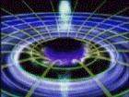
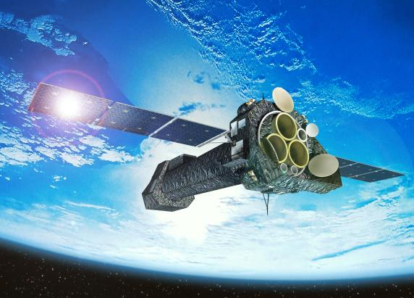
XMM-Newton Observatory
Measured iron in clumps of x-ray heated matter swirling around rotating black holes at 10% the speed of light.
Confirmed the signatures predicted near black holes by Albert Einstein's theory of Relativity in the light of the cosmic X-ray background.
Measured black holes spinning space around it like a flywheel.
Launched in December 1999 by European Space Agency (ESA).
Notes:
ESA’s XMM-Newton Observatory
The X-ray Multi-mirror – Newton mission, launched in December 1999 and still operating today, is especially designed to obtain spectra of X-ray sources such as black holes. It is named in honor of Sir Isaac Newton, the first person to write down equations that accurately described classical gravity. It has studied in detail the X-ray emission from accretion disks around black holes, as well as X-rays from the black holes in active galaxies, and from gamma-ray bursts. It has spied matter as it swirls around black holes just moments before falling in, X-rays from the supermassive black hole in our Milky Way Galaxy, as X-rays from thousands of black holes in other galaxies.
XMM-Newton ESA science site - http://sci.esa.int/science-e/www/area/index.cfm?fareaid=23
Education and Public Outreach pages - http://xmm.sonoma.edu/index.html
Goddard Space Flight Center's XMM-Newton page - http://heasarc.gsfc.nasa.gov/docs/xmm/xmmhp_aboutxmm.html

Slide 9
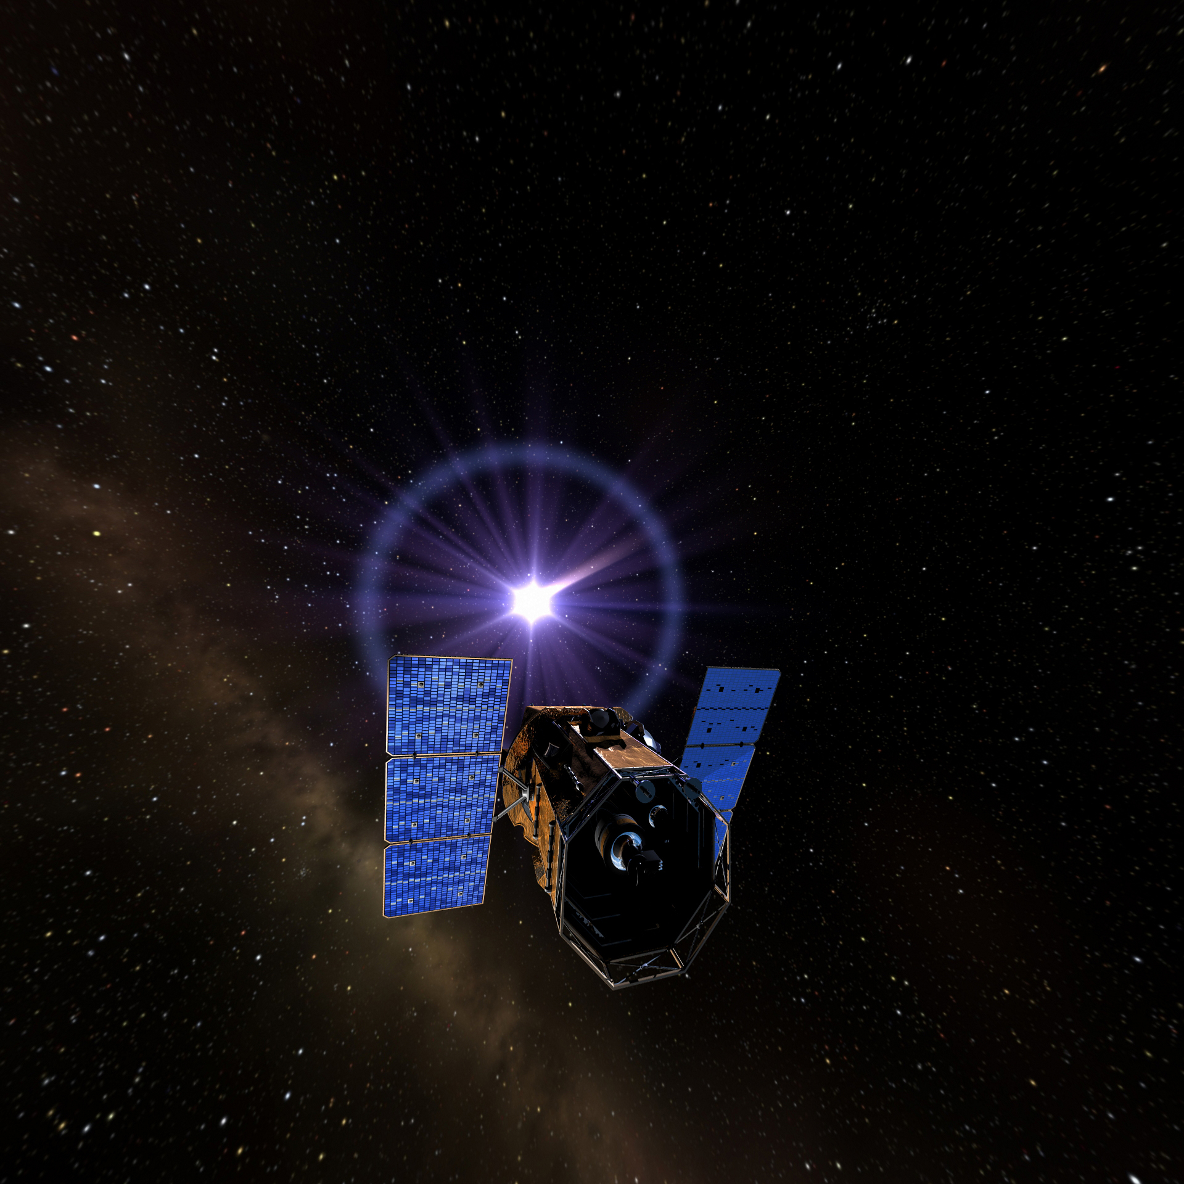
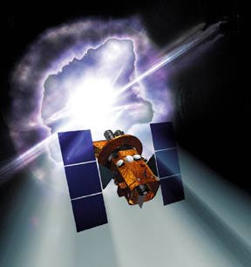
Swift Explorer Satellite
Launched November 20, 2004
Has observed over 200 gamma ray bursts
The birth cry of black holes
Three coaligned telescopes to cover gamma-rays through visible light.
Has already made several major discoveries regarding GRBs.
Launch is featured in planetarium show.
Notes:
Swift Gamma-ray Burst Explorer Satellite
The Swift mission investigates the almost unimaginably violent explosions called gamma-ray bursts, tremendous supernovae and voracious black holes gobbling down matter at fantastic rates. Swift is a NASA satellite launched on November 20, 2004 and is still operating today . Swift’s primary mission is to observe gamma ray bursts, extraordinary explosions of matter and energy that astronomers think signal the births of black holes. These explosions, as huge as they are, fade very rapidly, so Swift must react quickly to study them. The satellite moves so quickly that astronomers decided to name it Swift, after a bird that can dive at high speed to catch its target. It is one of a very few NASA missions that has an actual name and not an acronym!
Swift project site: http://swift.gsfc.nasa.gov/docs/swift/swiftsc.html
Swift education and public outreach site: http://swift.sonoma.edu/

Slide 10

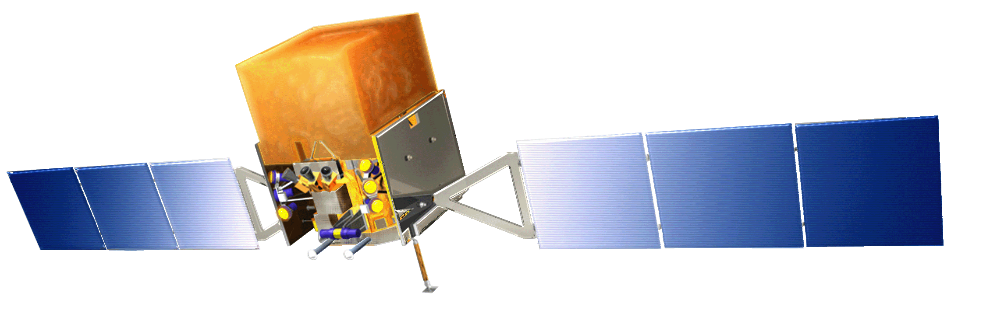
Fermi Gamma-ray Space Telescope
Launched June 11, 2008
Studies gamma rays (like the kinds emitted from active galaxies)
http://fermi.sonoma.edu

Slide 11
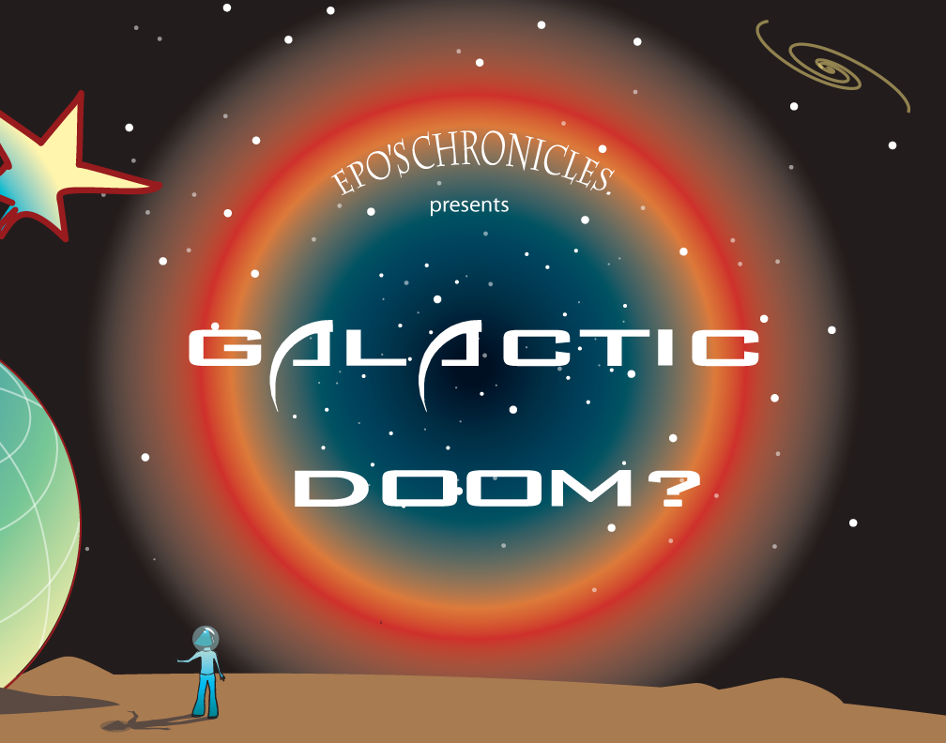
Galactic Doom
Learn about Galaxies and determine the fate of the Milky Way
http://mystery.sonoma.edu

Slide 12
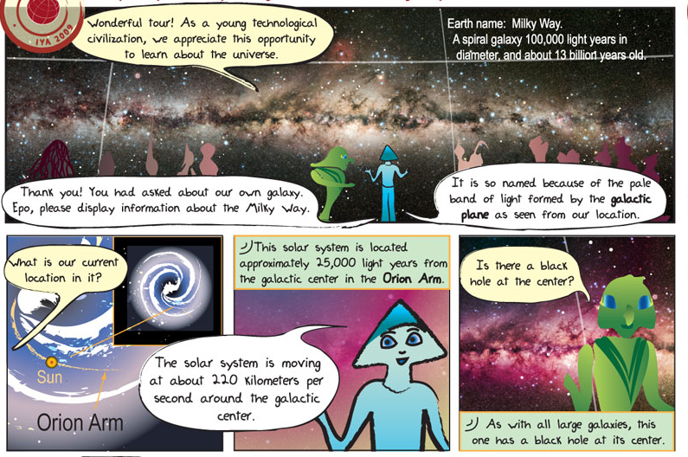
Epo’s Chronicles
http://www.eposchronicles.org
Take a cosmic journey of discovery
with Alkina and spaceship Epo.

Slide 13
Final Activity
With your students….
Play the Fermi Race Game – Be the first to build your own Femri satellite and make observations
LAT
GBM
Notes:
Procedure:
Discuss the last two questions in the background information on page 7.
Hand out the student handout. As a homework, individual in-class, or group assignment instruct the students to do one of the following.
Create a presentation that describes one or more of the black hole missions or observations.
Make a poster that explains the past or future black hole missions or observations.
Write an essay about the NASA science missions
Be creative; create/design something that will aid a presentation on this topic.
In order to complete this project the students will have to research their topics online. The information provided in the handout is not sufficient to complete the project, this is only enough to give them a start.
After they have created their project, have the students give their presentations. After each presentation, lead a discussion about how this relates to what they have learned during the course of this guide and what other questions they have about the discoveries and/or properties of black holes.

Slide 14
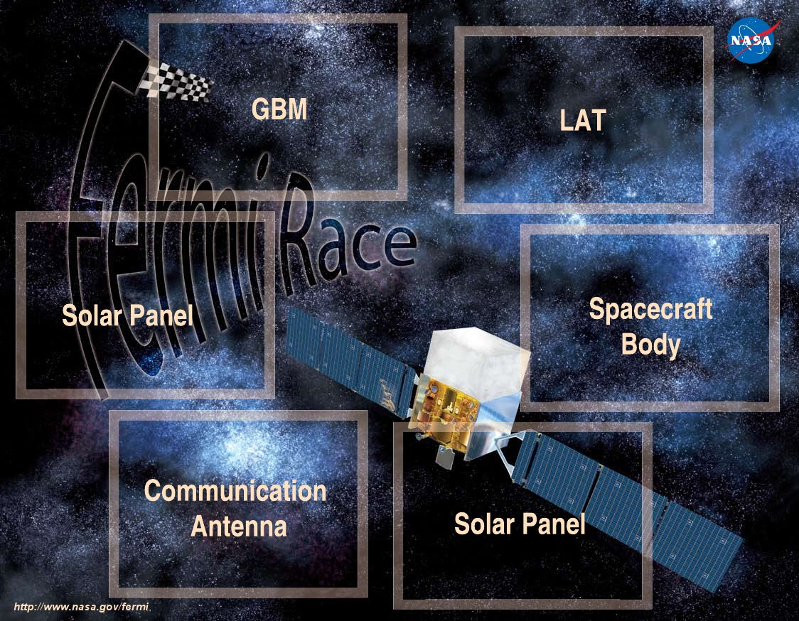
Final Activity
Final Activity
Play the Fermi Race Game
Be the first to build your own Femri satellite and make observations

Slide 15
Wrap up
Section 1 - The Formation of Black Holes
Activity 1 – Tasty Active Galaxies
Section 2 - The gravity of the situation (around black holes)
Activity 2 - Black Hole Space Warp
Section 3 - Travel Inside the Black Hole at the Center of the Milky Way
Activity 3 – Science Fiction or Fact
Section 4 - The Search for Black Holes
Activity 4 – Fermi Race Card Game
Notes:
Use this slide to remind participants what was covered during the course of the workshops. Open the floor for discussion about any topic covered during the day.

Slide 16
Resources
http://fermi.sonoma.edu - then see Educators/Public 🡪 Printed Materials for downloadable versions of all of today’s activities.
http://www.nasa.gov/fermi - the official NASA website for Fermi
http://epo.sonoma.edu – our group’s main page

