Slide 1
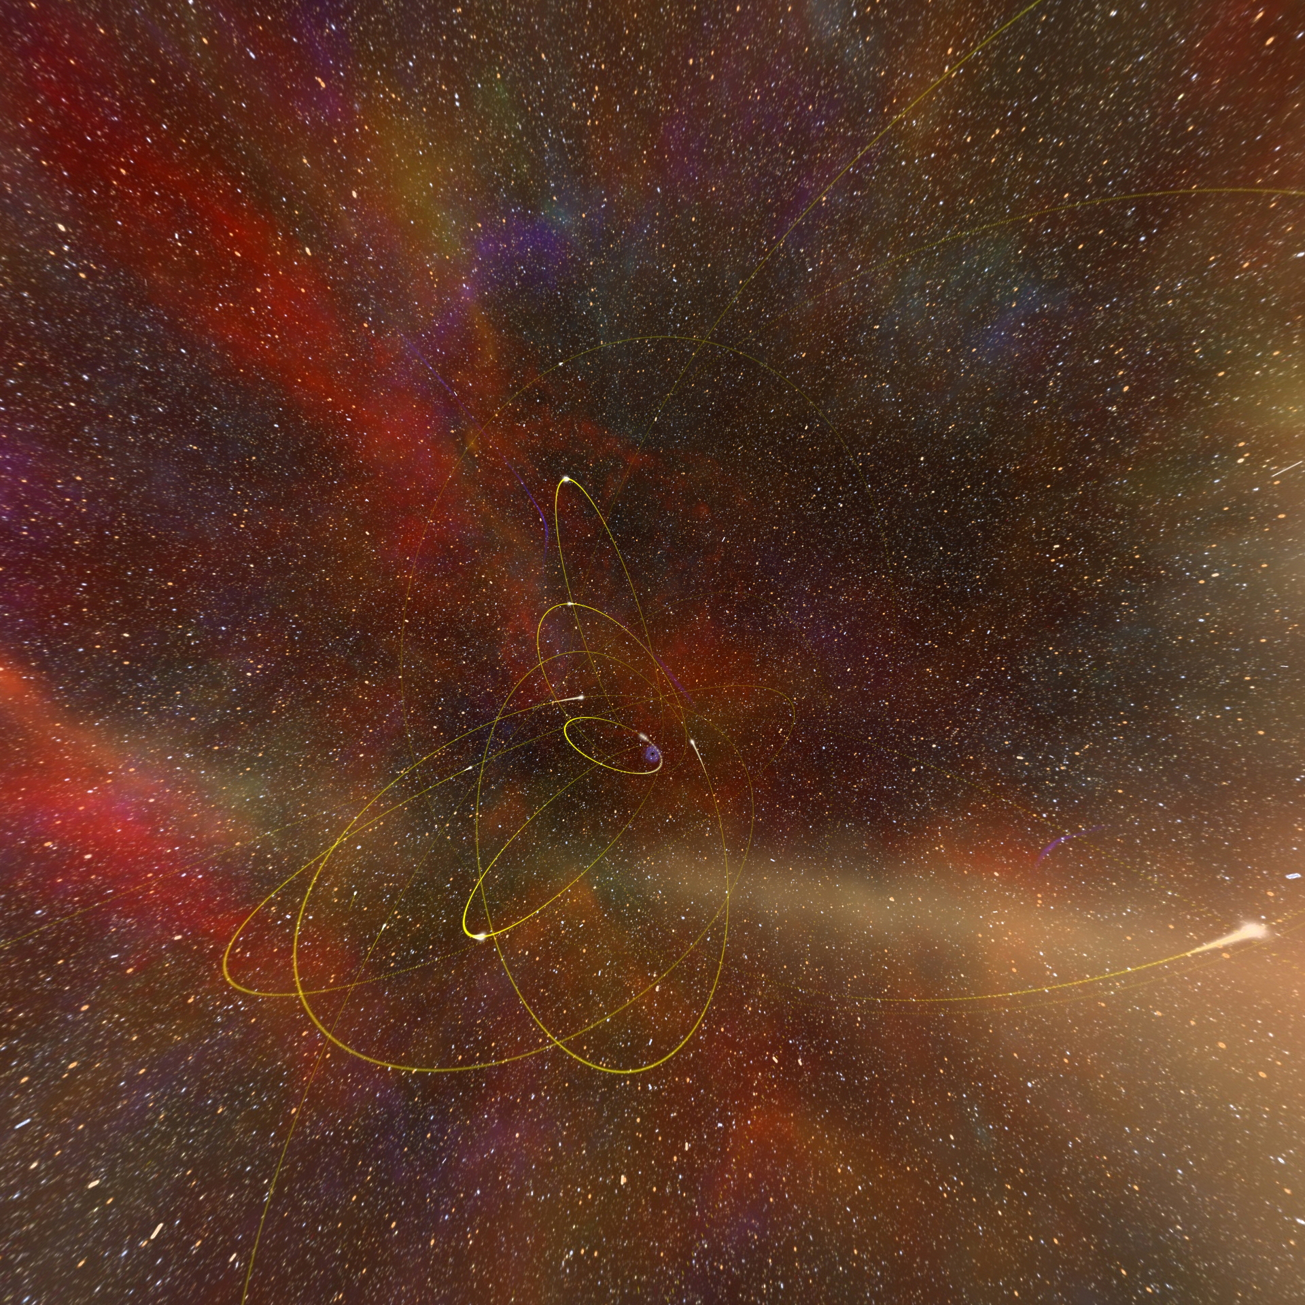
Section 3
Travel Inside the Black Hole at the Center of the Milky Way
Notes:
In this section, we will address the fundamental question:
Can black holes be used to travel through spacetime?
At the end of the planetarium show, there is a stunning sequence developed by Prof. Andrew Hamilton in which Einstein’s equations of General Relativity are used to calculate the actual effects on light from the surrounding galaxy. This “Black Hole Flight Simulator” portrays what it would look like to fall into the black hole at the center of our Milky Way Galaxy. As part of this sequence, the instability near the central singularity is “turned off” in the equations, to show what it could be like to exit through a tunnel in spacetime, called a “wormhole” into another part of our galaxy or into another Universe. In this section, we are going to explore popular depictions of these types of wormhole travel events and learn how to separate science fact from science fiction.

Slide 2
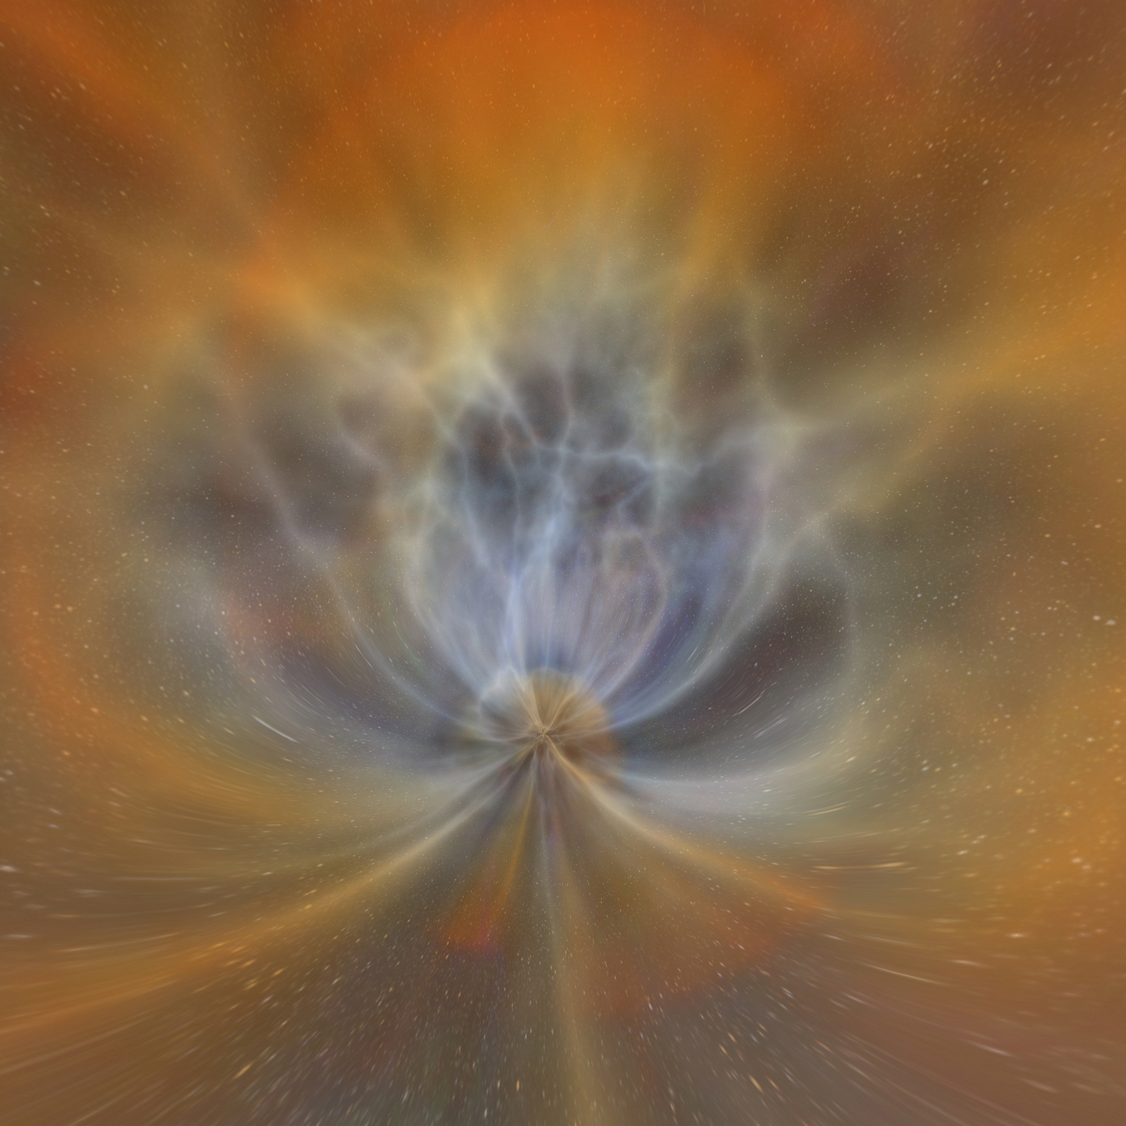
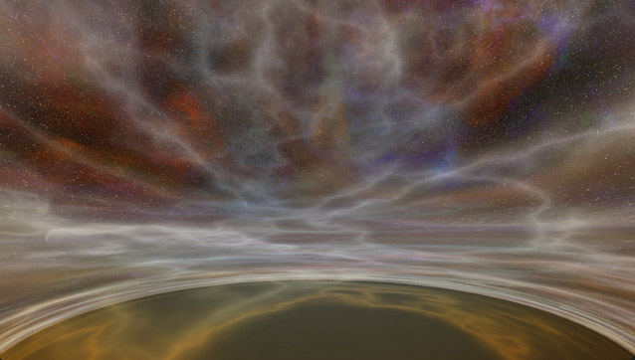
Approach to the black hole
Notes:
Approach to a black hole
In this still frame from the Black Hole Flight Simulator, you see how the black hole warps space and twists light like a giant lens.

Slide 3

Inside of the black hole
Notes:
Inside of a black hole
The inside of a spinning black hole is not black at all— it contains all the energy and matter the black hole ever pulled across its event horizon. This is the maelstrom at the singularity, where the infalling energy and matter collide with the turbulence caused by the singularity.

Slide 4
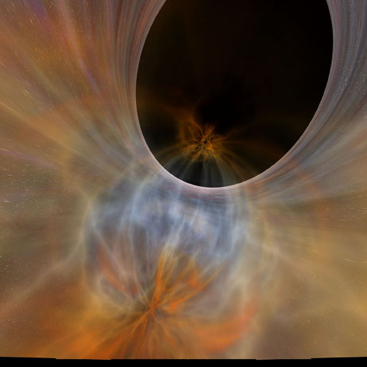
Formation of the wormhole
Notes:
Approaching the wormhole
In this image, the maelstrom around the singularity (shown in the previous slide) is visible at the bottom center, while the instabilities in Einstein’s equations are mathematically turned off to allow the formation of a tunnel of warped spacetime that opens to another part of our Galaxy or a different Universe. Although not possible to travel through this wormhole, it is possible to mathematically calculate its effect on the light and matter nearby, which is lensed almost completely around this new singularity (shown in the upper right).

Slide 5
Can black holes be used to travel through spacetime?
In reality, this probably won’t work.
While wormholes appear to be possible mathematically, they would be violently unstable, or need to be made of theoretical forms of matter which may not occur in nature.
Notes:
Can black holes be used to travel through spacetime?
It’s a science fiction cliché to use black holes to travel through space. Dive into one, the story goes, and you can pop out somewhere else in the Universe, having traveled thousands of light years in the blink of an eye.
But that’s fiction. In reality, this probably won’t work. Black holes twist space and time, in a sense punching a hole in the fabric of the Universe. There is a theory that if this happens, a black hole can form a tunnel in space called a wormhole (because it’s like a tunnel formed by a worm as it eats its way through an apple). If you enter a wormhole, you’ll pop out someplace else far away, not needing to travel through the actual intervening distance.
While wormholes appear to be possible mathematically, they would be violently unstable, or need to be made of theoretical forms of matter which may not occur in nature. The bottom line is that wormholes probably don’t exist. When we invent interstellar travel, we’ll have to go the long way around.
In order to physically pass through a wormhole, you would have to survive the maelstrom of swirling matter and infinitely dense compression that occurs at the singularity – the very center – of the black hole. We don’t know of any way to do this, and so it’s almost certainly true that travel through a wormhole is not physically possible. This chaotic region inside the black hole is shown near the end of the planetarium show, and the narrator mentions that if you hit it, you’re dead. However, from there, the planetarium show “turns off” this aspect of a black hole, mathematically ignoring the destruction inside, so that you can see what would happen if you could actually pass through the black hole and into the wormhole. In reality, we wouldn’t be able to turn off these extremely turbulent and destructive forces, so any normal matter would be destroyed long before it reached the singularity, preventing travel through it into the wormhole.

Slide 6
Can black holes be used to travel through spacetime? They do it in the movies
Now we are going to look at a few movie clips.
While viewing the clips take notes about what is “Science Fact” and what is “Science Fiction.”
Notes:
Television and movies have made travel through spacetime wormholes seem easy. However, we do not know of any way to physically survive the turbulence and extreme gravitational compression that exist near the singularity. Try to keep this in mind while viewing these clips.

Slide 7
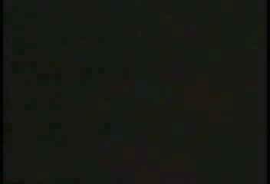
Ren and Stimpy Black Holes
Notes:
Ren & Stimpy Episode: Black Hole Original Production Number- RS06a
This clip can only be used for educational purposes only. This is protected by US copyright laws.
http://www.usg.edu/legal/copyright/teach_act.phtml

Slide 8
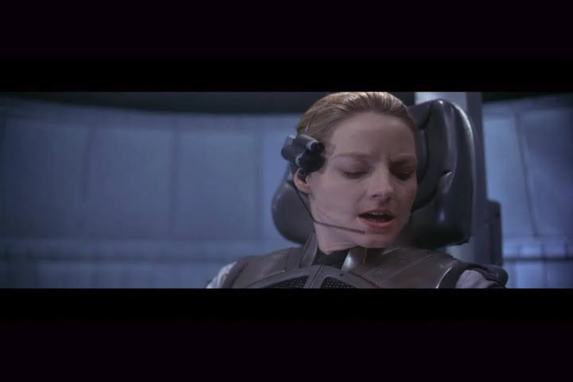
The Movie Contact
Notes:
Contact Produced by Warner Brothers 1997: start time: 1:51:20 stop time: 1:59:39
This clip can only be used for educational purposes only. This is protected by US copyright laws.
http://www.usg.edu/legal/copyright/teach_act.phtml

